Slide 1


Sabina commissioning
Beam dynamics Simulations
G. J. Silvi
Check the alignment of all elements from SBNFLAG01 up to the undulator entrance.
Have a reference beam available for the commissioning of the beamline.
On behalf of the SPARC_LAB and SABINA collaboration

Slide 2
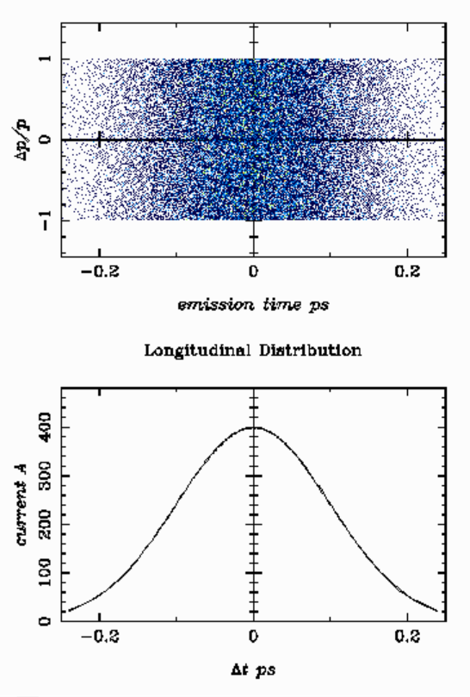
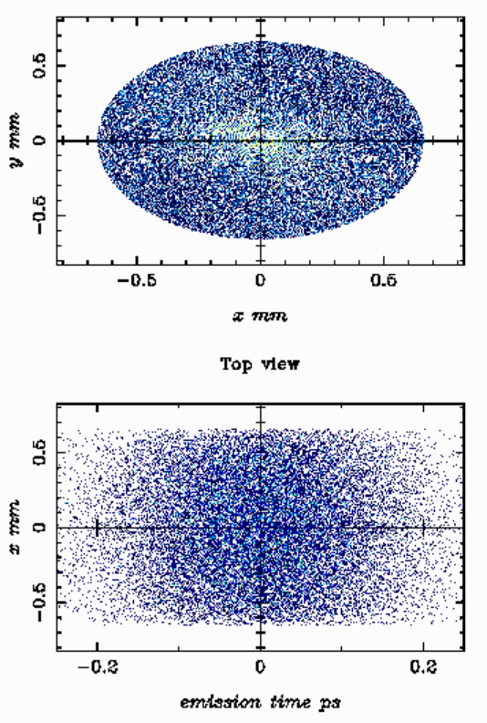
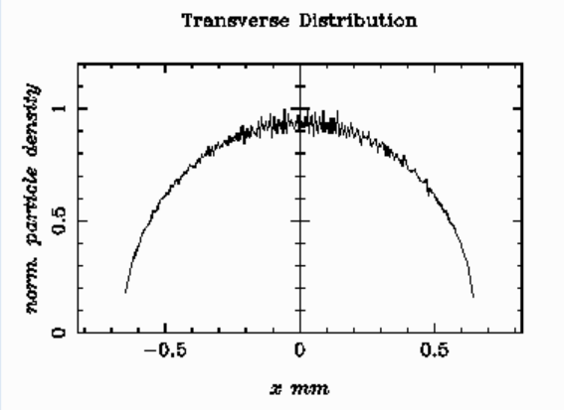
Cathode parameters
Parametro | Valore
Numero di macroparticelle | 100000 | Particelle
Carica totale (Q_total) | 0.100 pC | Carica totale
Distribuzione longitudinale | Gaussian | Profilo temporale/longitudinale gaussiano
Bunch length | 100 fs | Larghezza RMS della distribuzione temporale
Distribuzione energetica | isotropica | Distribuzione energia
Distribuzione trasversa | Radiale | Distribuzione cilindricamente simmetrica
Dimensione RMS trasversa | 0.33 mm | Raggio RMS del fascio (x2)
Distribuzione dell'impulso trasverso | Radiale uniforme | Distribuzione radiale dell'impulso trasverso

Slide 3
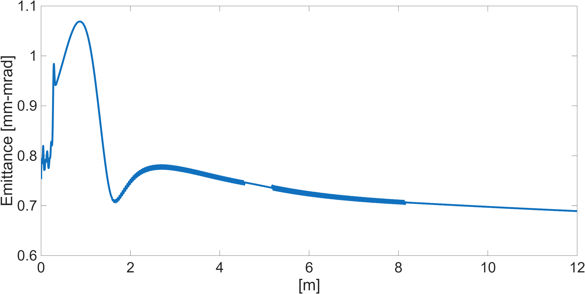
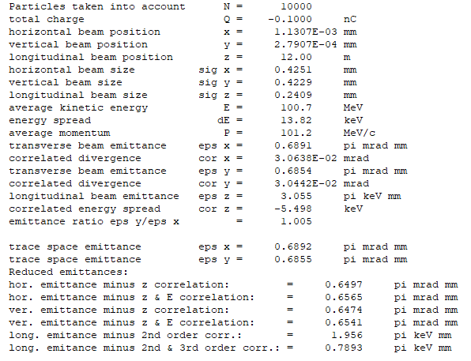
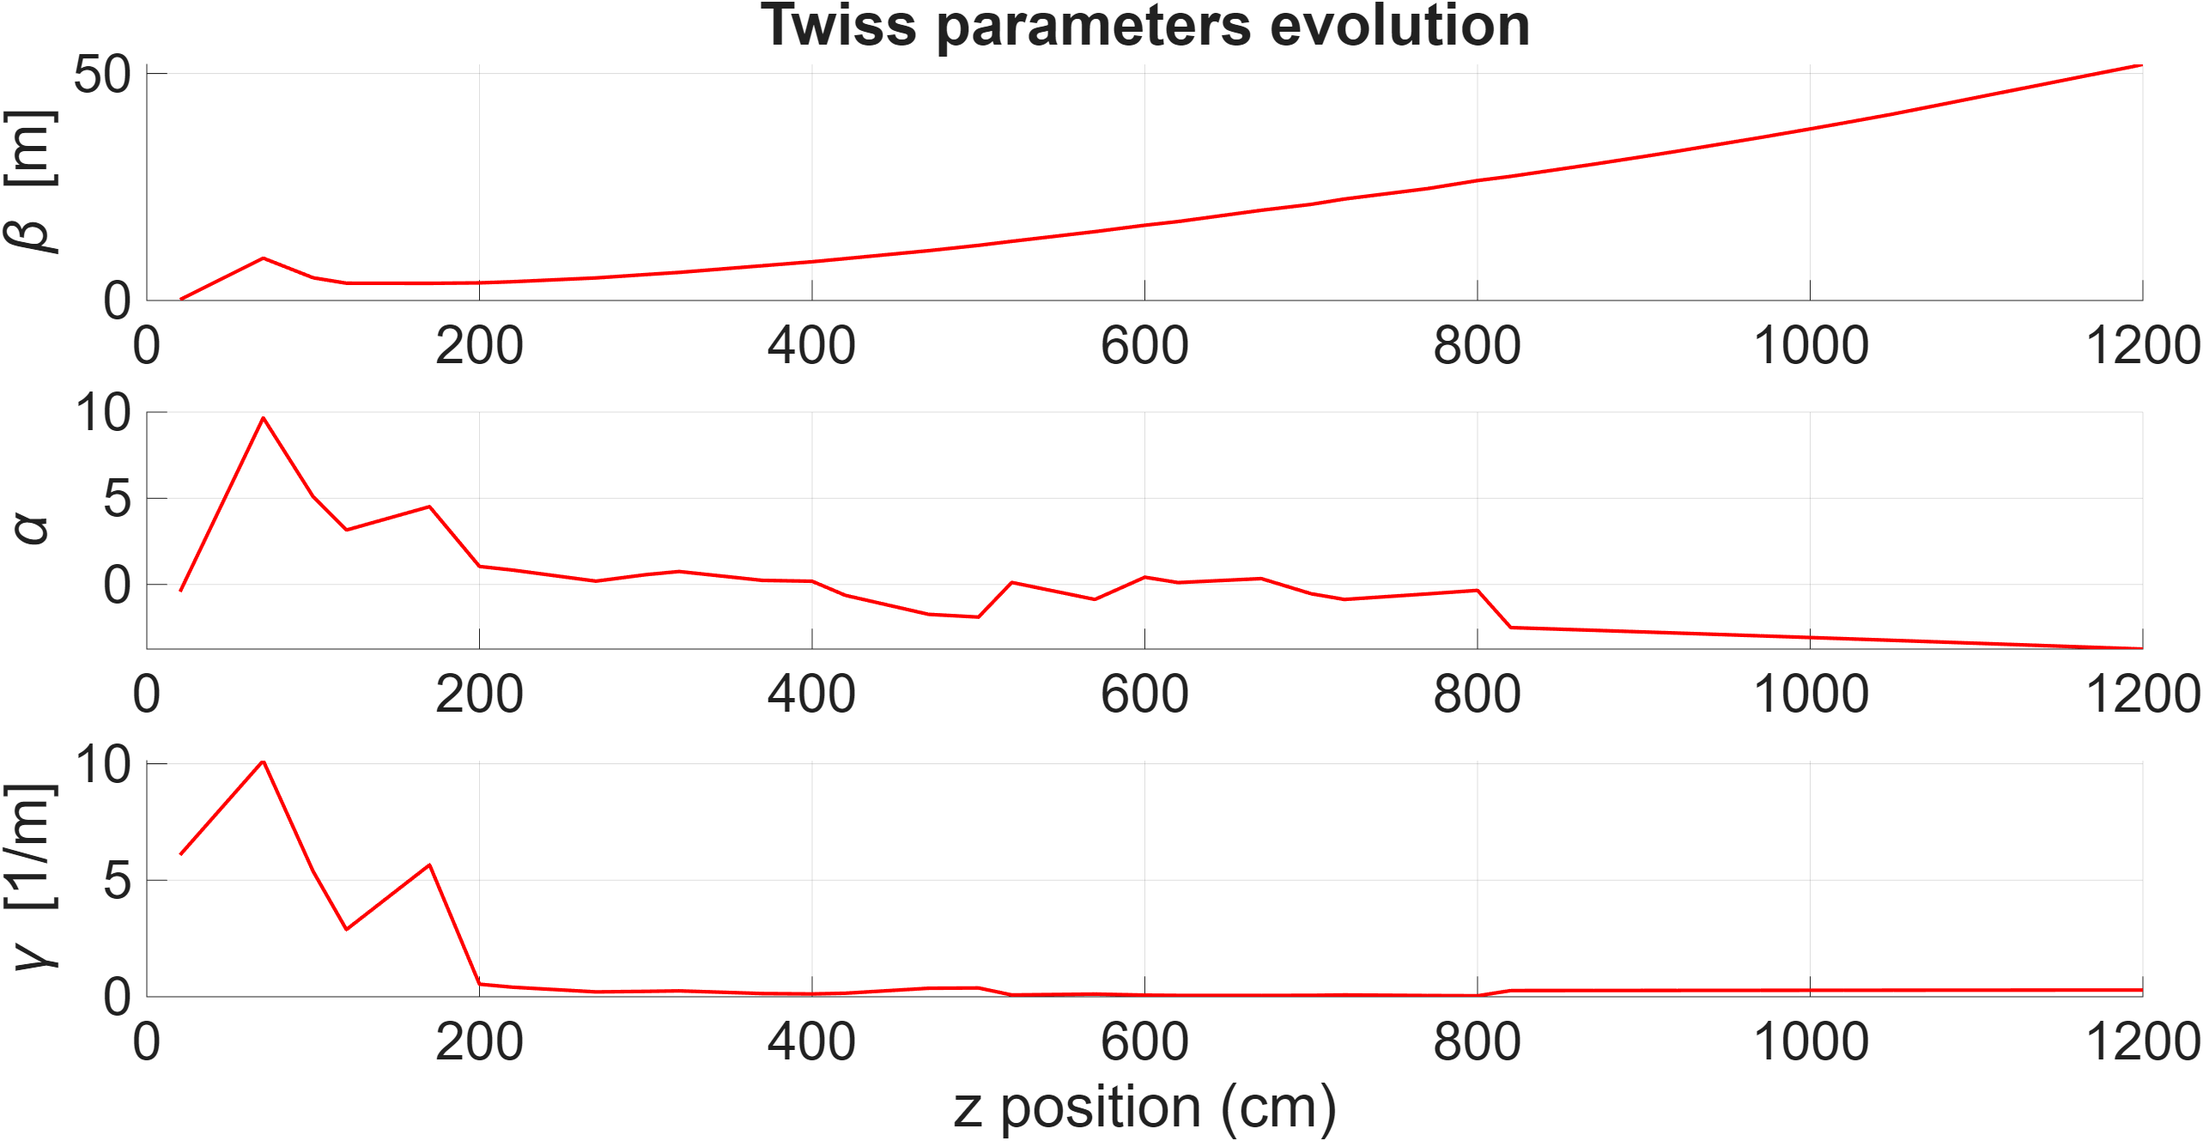
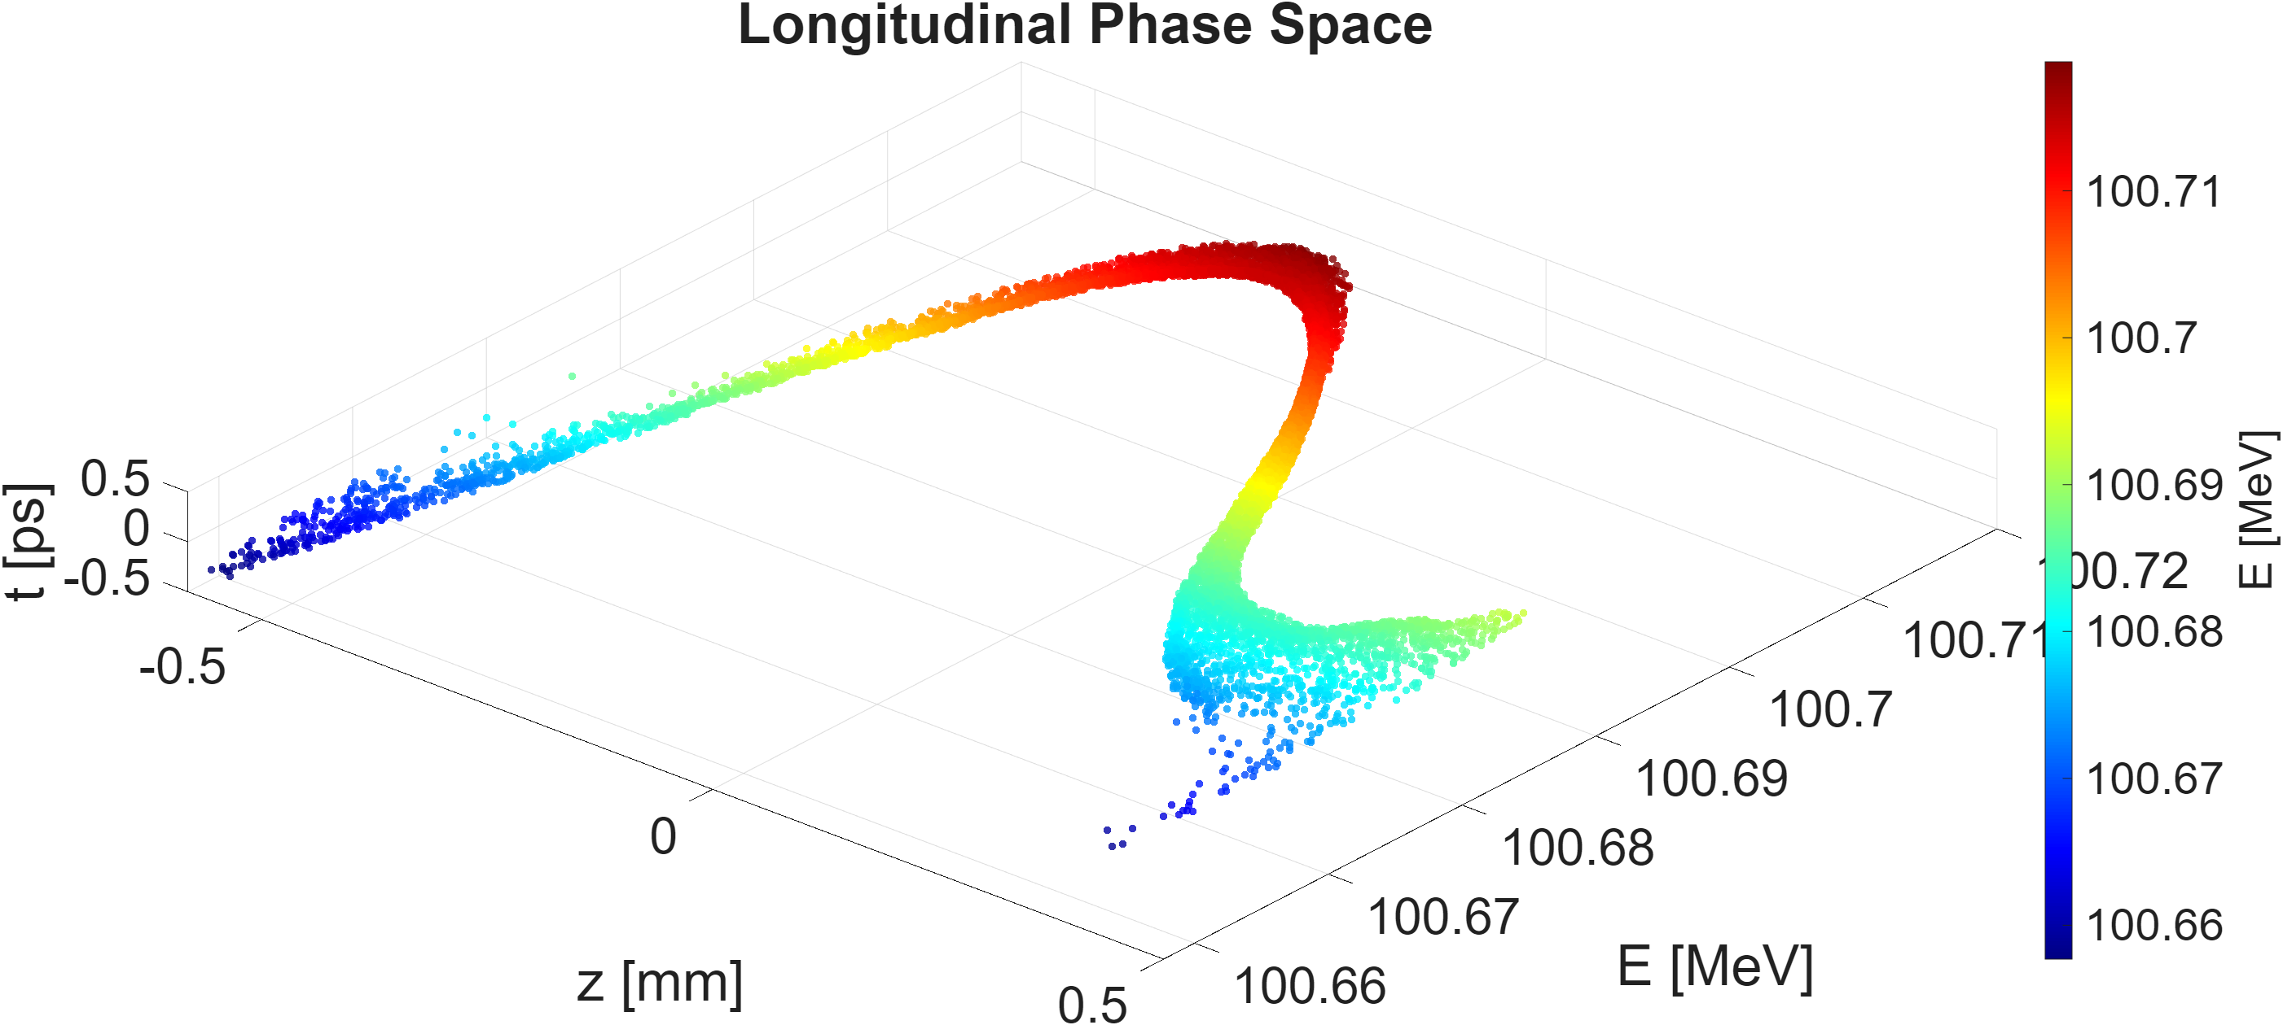
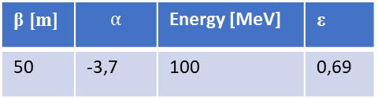
100 MeV on crest Linac simulation
β [m] | $$α$$ | Energy [MeV] | ε
50 | -3,7 | 100 | 0,69

Slide 4
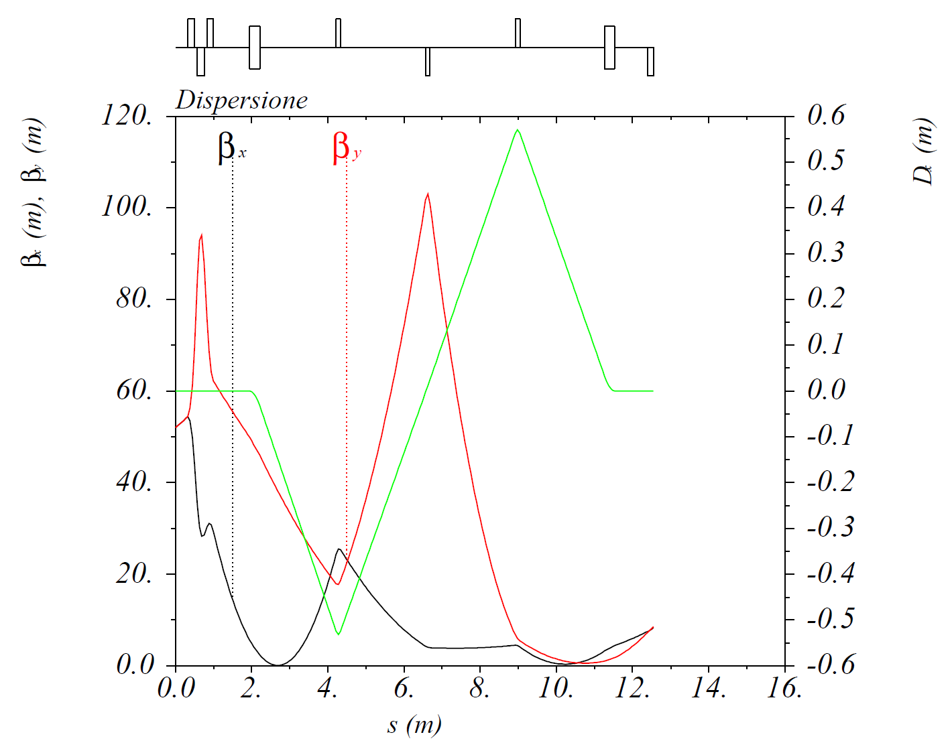
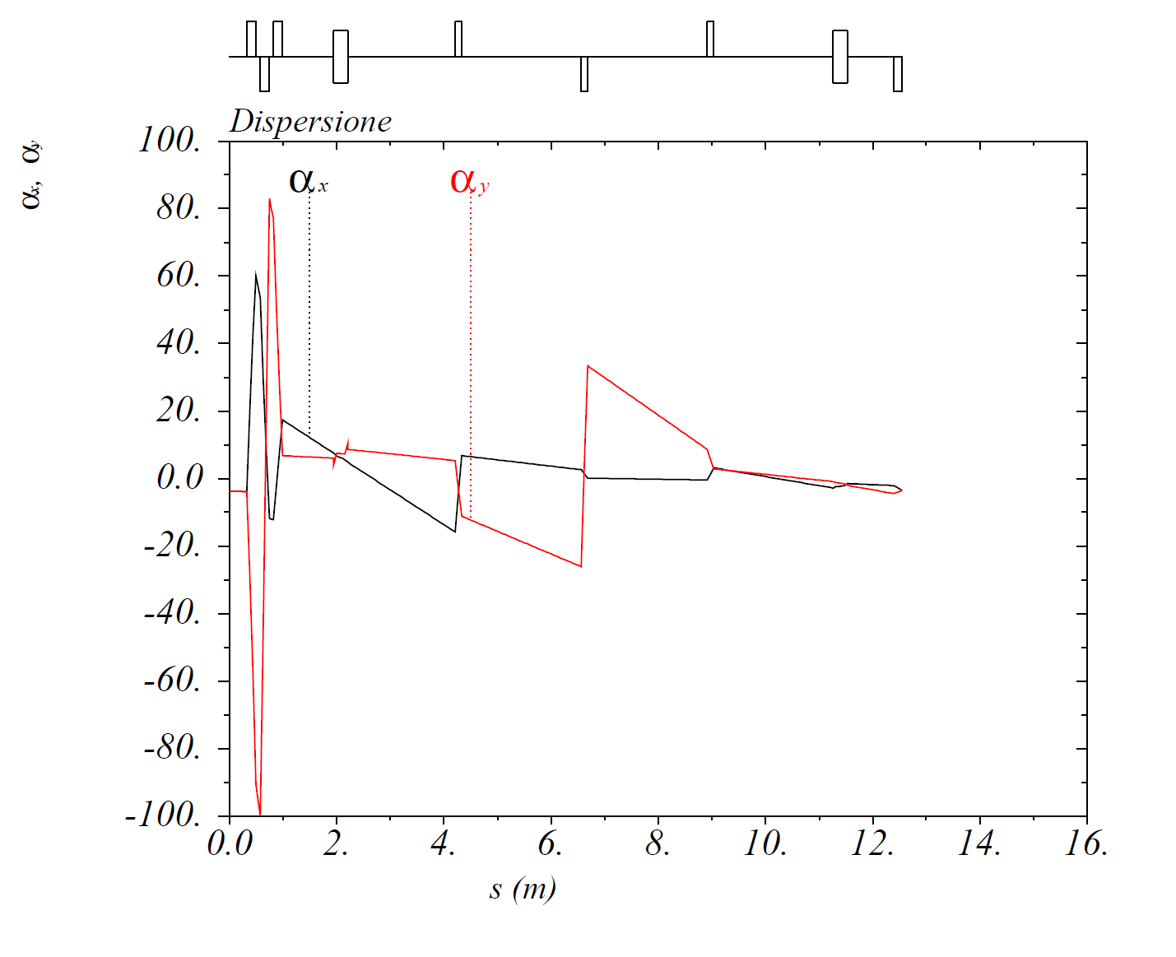
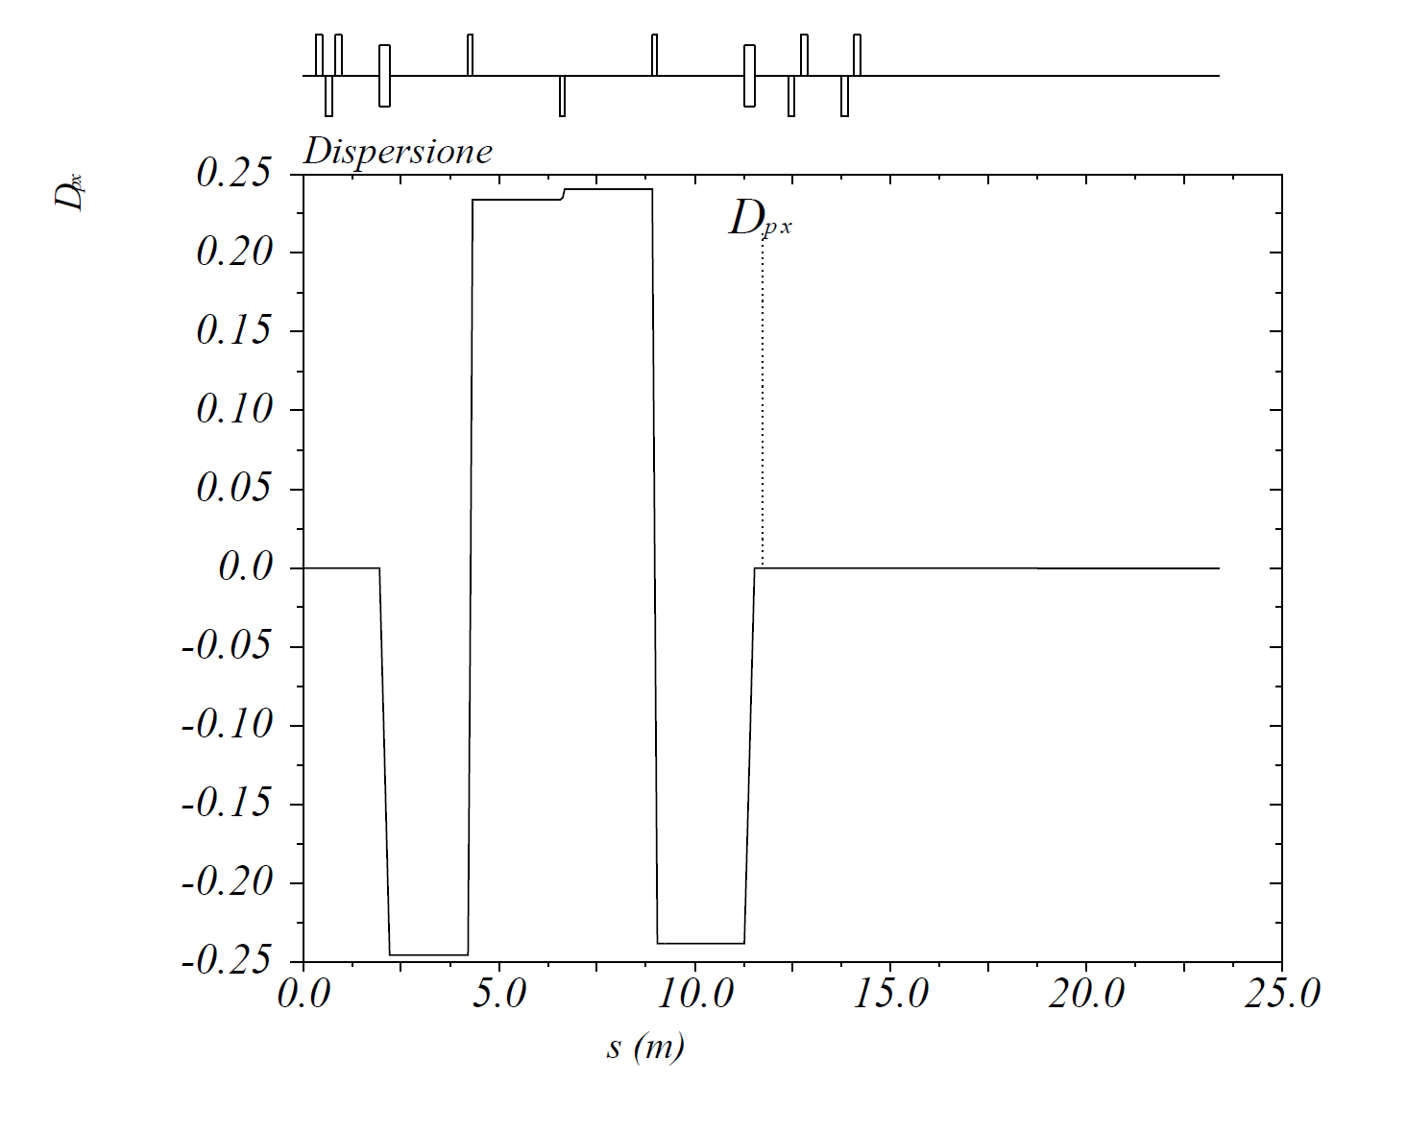
DOGLEG simulation for 100 MeV on crest beam

Slide 5
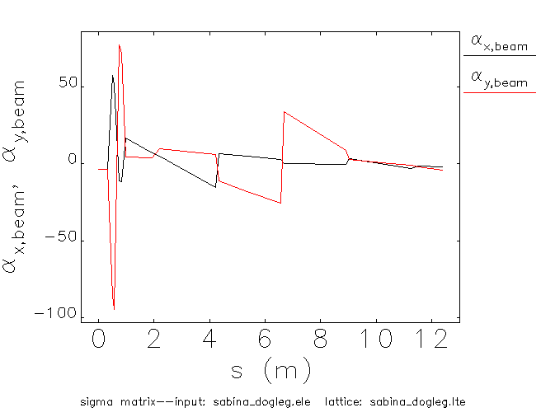
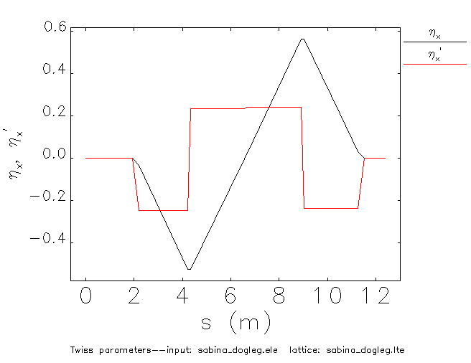
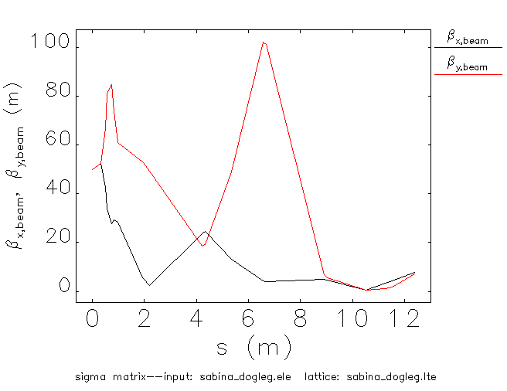
DOGLEG simulation for 100 MeV on crest beam

Slide 6
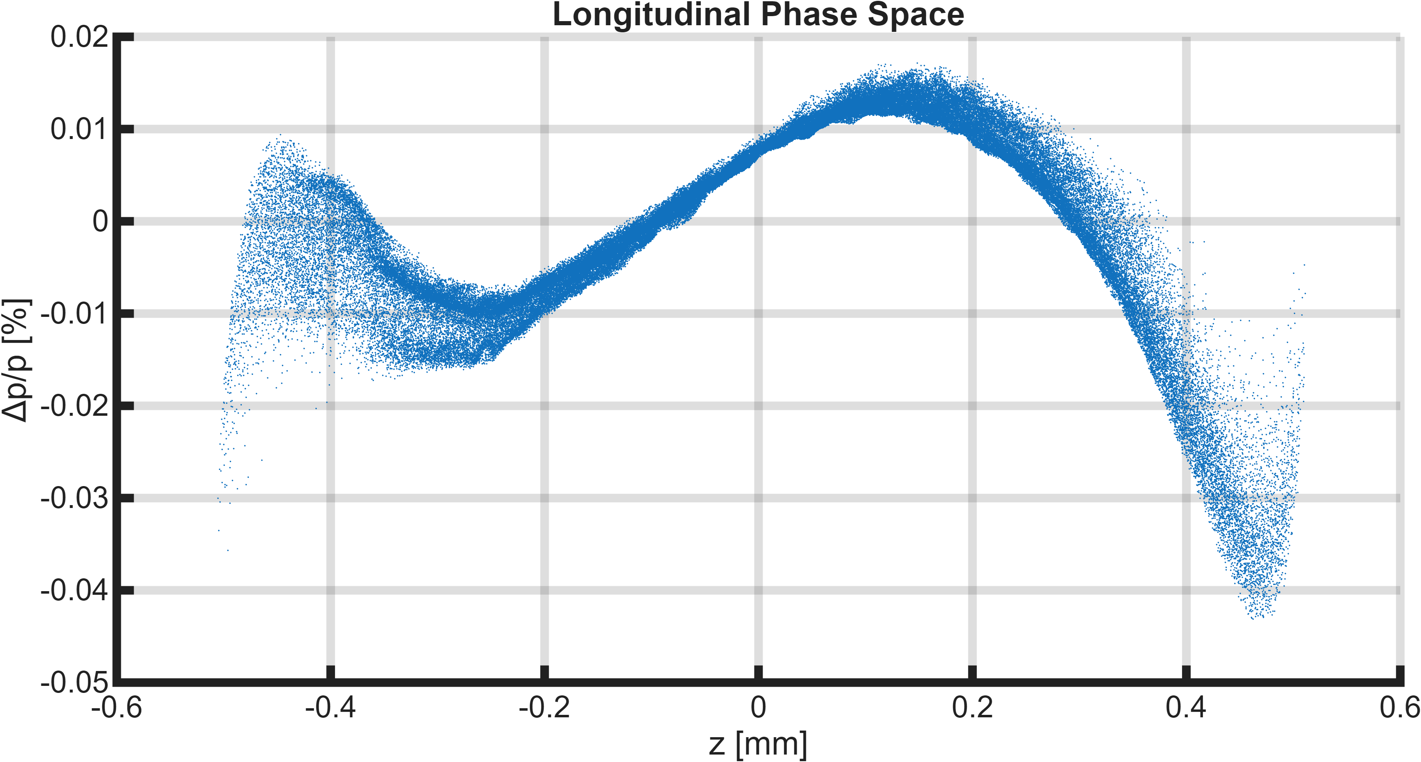
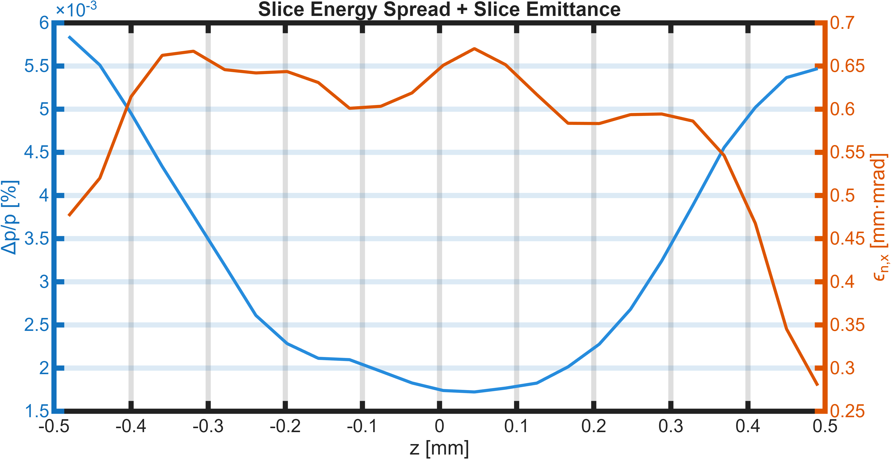
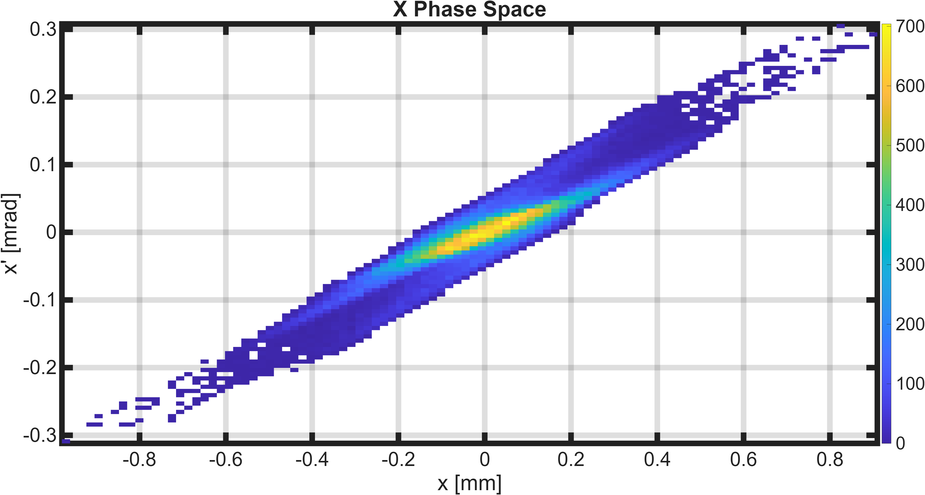
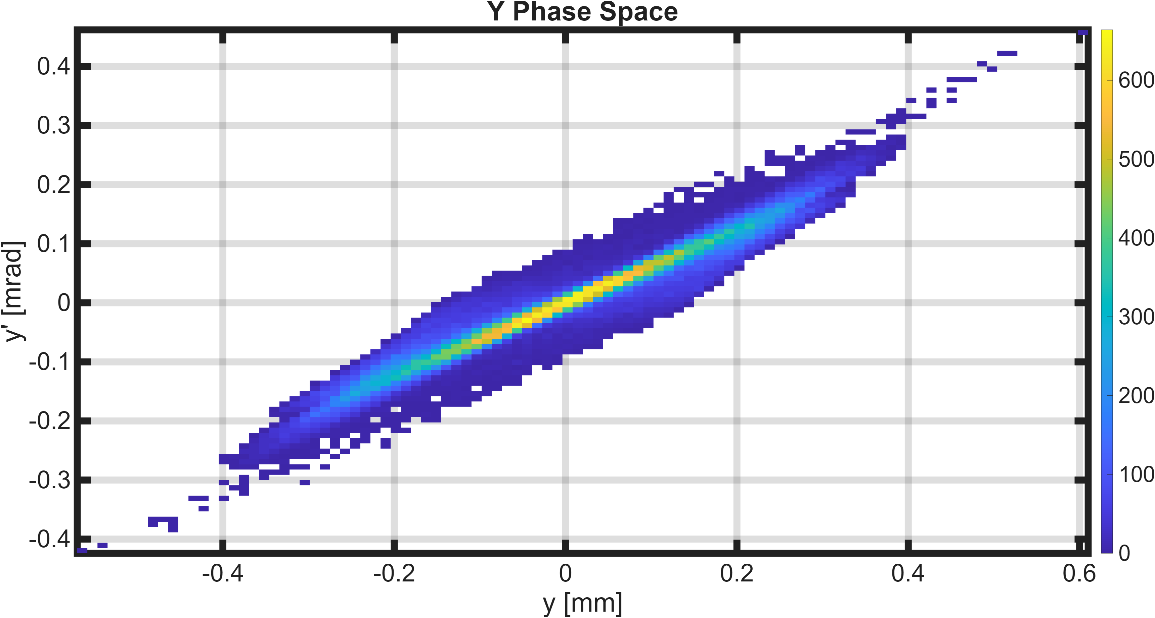
DOGLEG simulation for 100 MeV on crest beam

Slide 7
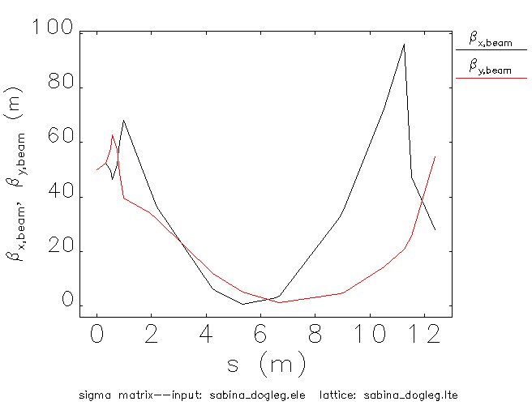
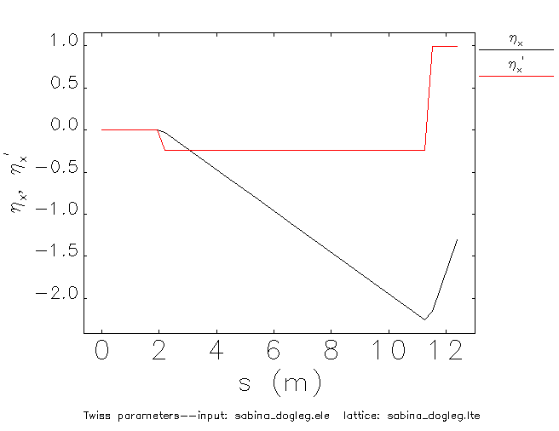
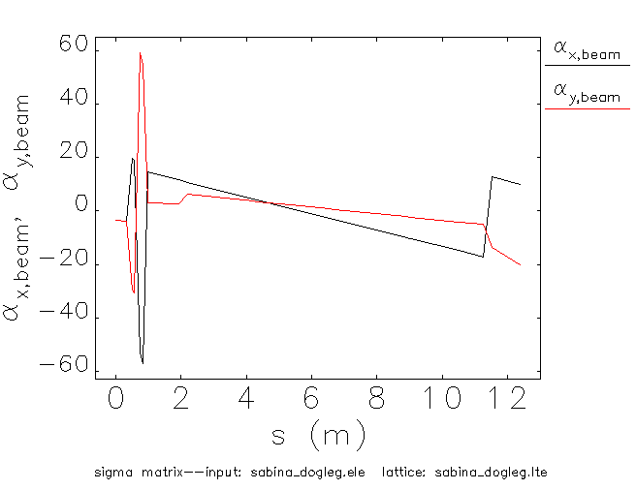
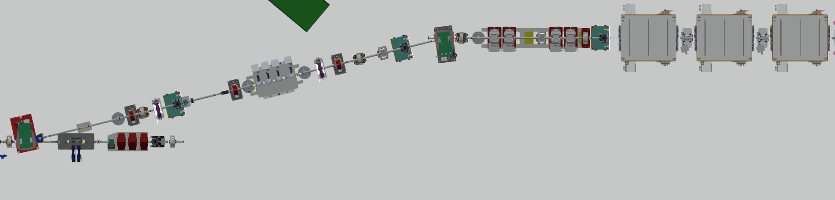
100 MeV on crest beam propagated with no DGL quads to check alignment
SBNQUA01
SBNDPL01
SBNDPL02
SBNQUA03
SBNQUA02

Slide 8
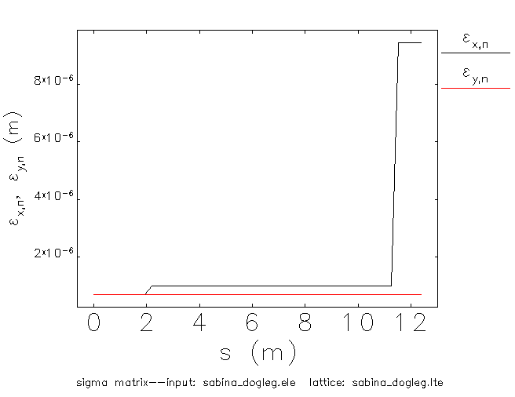
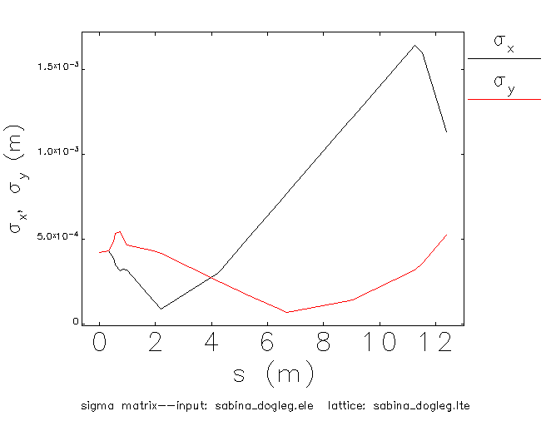
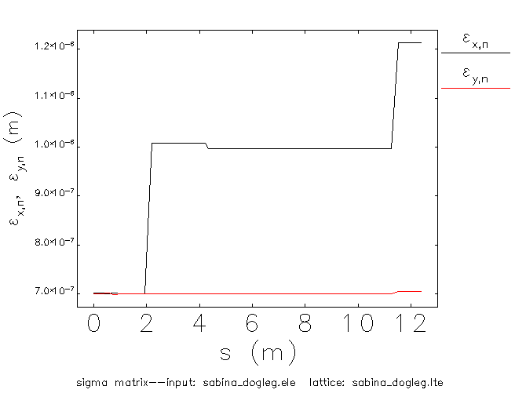
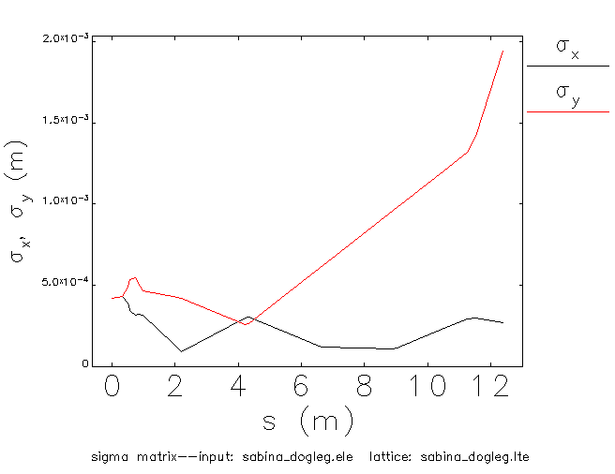
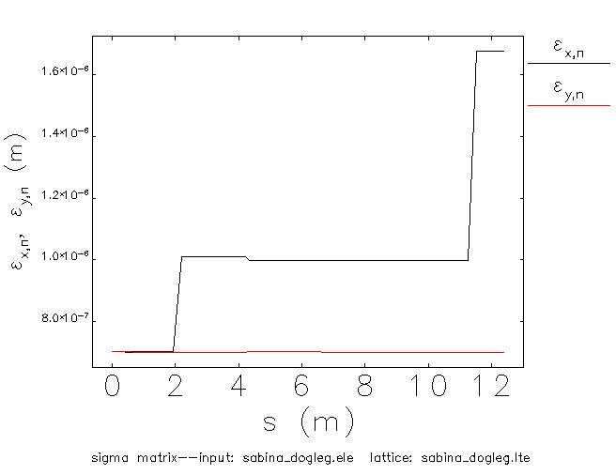
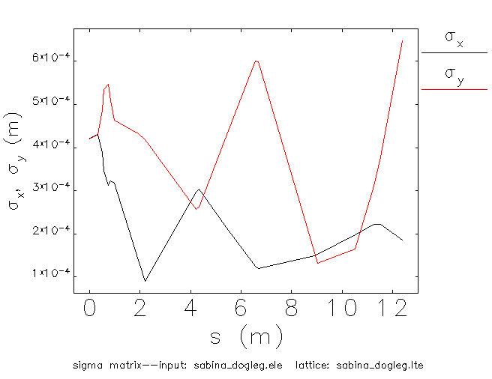
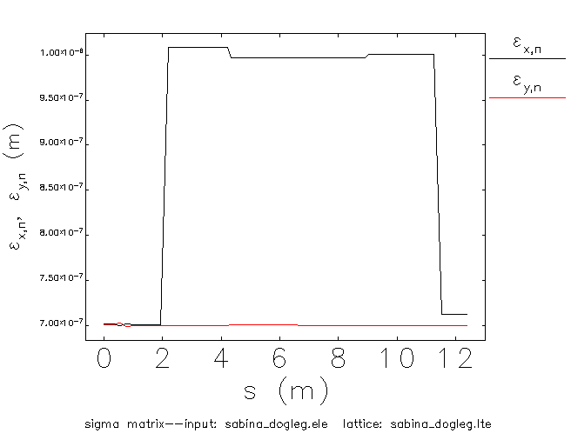
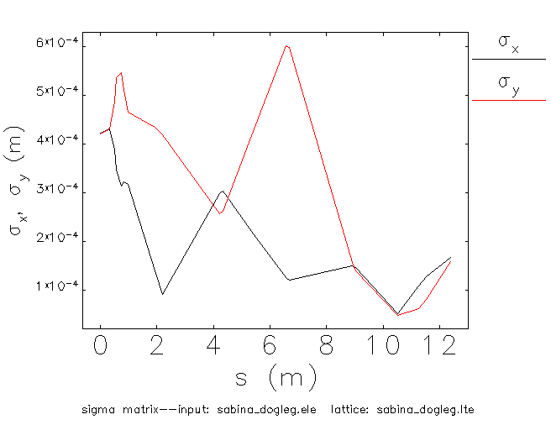
100 MeV on crest beam propagated with no DGL quads to check alignment
NO SBNQUA
SBNQUA01 ON
SBNQUA01/02 ON
ALL SBNQUA

Slide 9
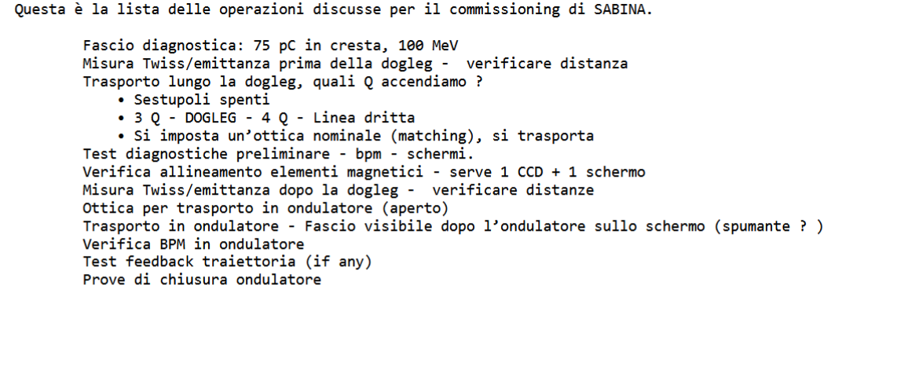
Proposta di Luca Giannessi

Slide 10
FASCIO DIAGNOSTICA 75pC in cresta, 100 MeV
Twiss/emittance measurement before dogleg ‐ check distances
Check all diagnostics, FLG’s motors and cameras; BPMs;
Dogleg transport:
  Check on SBFLG02 (right before the last dipole)
    Everything OFF (cavity aligned and magnets OFF) – set the trajectory
    Powering in order the quadrupoles and fixing the alignment
  Check on SBLFLG03 (right before the undulators)
    Everything OFF – set the trajectory
    Powering the quadrupoles and fixing the alignment
Twiss/emittance measurement after the dogleg ‐ check distances
-------------------------------------------------
Optics of in undulators transport (undulators open)
In undulators transport – electrons visible after the undulators
Check BPM intra undulators
Test Trajectory feedbacks (if any)
----------------------------------------------------
Test undulators closing procedure
In undulators transport – electrons visible after the undulators
Check BPM intra undulators
Test Trajectory feedbacks (if any)
Proposta di Luca Giannessi

Slide 11
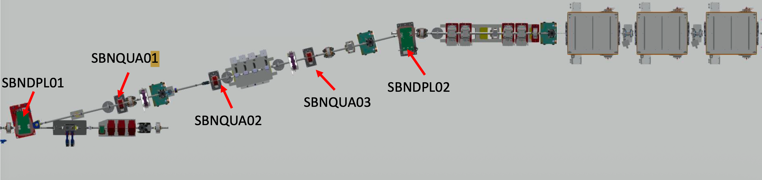
Dogleg transport:
Match PTL to nominal (Gilles WP) – Mark entrance reference in 1° dipole.
All SBNQ off - Transport to SBFLG02 & CENTER (right before the last dipole)
All SBNQ off– align SBNQUA01 X &Y using SBFLG01 & SBFLG02 (large in x for dispersion)
All SBNQ off– align SBNQUA02, SBNQUA03, in Y using SBFLG02 (only in Y because beam is large in X for dispersion)
All SBNQ off except SBNQUA01 (SBNQUA01 =nominal, -> beam contained in X, large in Y – align SBNQUA02, SBNQUA03, in X using SBFLG02 (only in X because beam is large in Y for defocusing of SBNQUA01)
Tune SBNQ 1,2,3 chicane to nominal setting dispersion off. Transport the beam to SBFLG03 with SBNQ 4,5,6,7 off. Center beam on SBFLG03, attempt transport to SBFLG04 with UM open. Set a straight line.
Align SBNQ 4,5,6,7 to the straight line using reference in SBFLG04
SBNQUA04,05,06
SBNFLG03
SBNFLG04
SBNFLG02
SBNFLG01

Slide 12
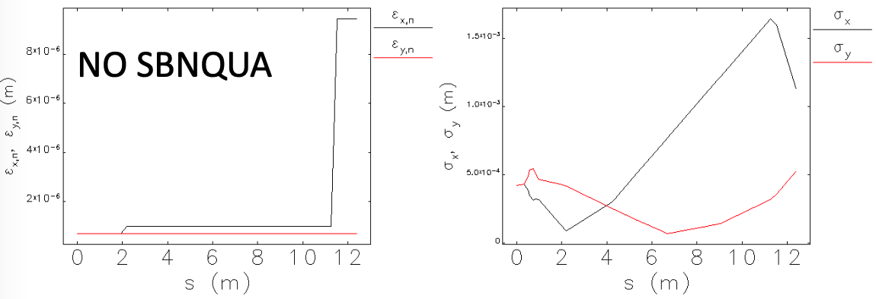
Dogleg transport:
Match PTL to nominal (Gilles WP) – Mark entrance reference in 1° dipole.
All SBNQ off - Transport to SBFLG02 & CENTER (right before the last dipole)
All SBNQ off– align SBNQUA01 X &Y using SBFLG01 & SBFLG02 (large in x for dispersion)
All SBNQ off– align SBNQUA02, SBNQUA03, in Y using SBFLG02 (only in Y because beam is large in X for dispersion)
All SBNQ off except SBNQUA01 (SBNQUA01 =nominal, -> beam contained in X, large in Y – align SBNQUA02, SBNQUA03, in X using SBFLG02 (only in X because beam is large in Y for defocusing of SBNQUA01)
Tune SBNQ 1,2,3 chicane to nominal setting dispersion off. Transport the beam to SBFLG03 with SBNQ 4,5,6,7 off. Center beam on SBFLG03, attempt transport to SBFLG04 with UM open. Set a straight line.
Align SBNQ 4,5,6,7 to the straight line using reference in SBFLG04
SBNQUA04,05,06
SBNFLG03
SBNFLG04
SBNFLG02
SBNFLG01

Slide 13
Dogleg transport:
Match PTL to nominal (Gilles WP) – Mark entrance reference in 1° dipole.
All SBNQ off - Transport to SBFLG02 & CENTER (right before the last dipole)
All SBNQ off– align SBNQUA01 X &Y using SBFLG01 & SBFLG02 (large in x for dispersion)
All SBNQ off– align SBNQUA02, SBNQUA03, in Y using SBFLG02 (only in Y because beam is large in X for dispersion)
All SBNQ off except SBNQUA01 (SBNQUA01 =nominal, -> beam contained in X, large in Y – align SBNQUA02, SBNQUA03, in X using SBFLG02 (only in X because beam is large in Y for defocusing of SBNQUA01)
Tune SBNQ 1,2,3 chicane to nominal setting dispersion off. Transport the beam to SBFLG03 with SBNQ 4,5,6,7 off. Center beam on SBFLG03, attempt transport to SBFLG04 with UM open. Set a straight line.
Align SBNQ 4,5,6,7 to the straight line using reference in SBFLG04
SBNQUA04,05,06
SBNFLG03
SBNFLG04
SBNFLG02
SBNFLG01

Slide 14
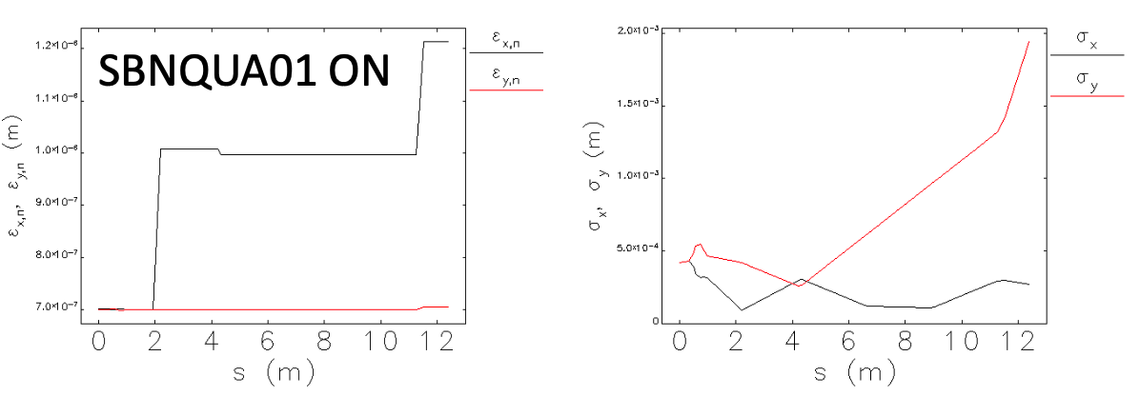
Dogleg transport:
Match PTL to nominal (Gilles WP) – Mark entrance reference in 1° dipole.
All SBNQ off - Transport to SBFLG02 & CENTER (right before the last dipole)
All SBNQ off– align SBNQUA01 X &Y using SBFLG01 & SBFLG02 (large in x for dispersion)
All SBNQ off– align SBNQUA02, SBNQUA03, in Y using SBFLG02 (only in Y because beam is large in X for dispersion)
All SBNQ off except SBNQUA01 (SBNQUA01 =nominal, -> beam contained in X, large in Y – align SBNQUA02, SBNQUA03, in X using SBFLG02 (only in X because beam is large in Y for defocusing of SBNQUA01)
Tune SBNQ 1,2,3 chicane to nominal setting dispersion off. Transport the beam to SBFLG03 with SBNQ 4,5,6,7 off. Center beam on SBFLG03, attempt transport to SBFLG04 with UM open. Set a straight line.
Align SBNQ 4,5,6,7 to the straight line using reference in SBFLG04
SBNQUA04,05,06
SBNFLG03
SBNFLG04
SBNFLG02
SBNFLG01

Slide 15
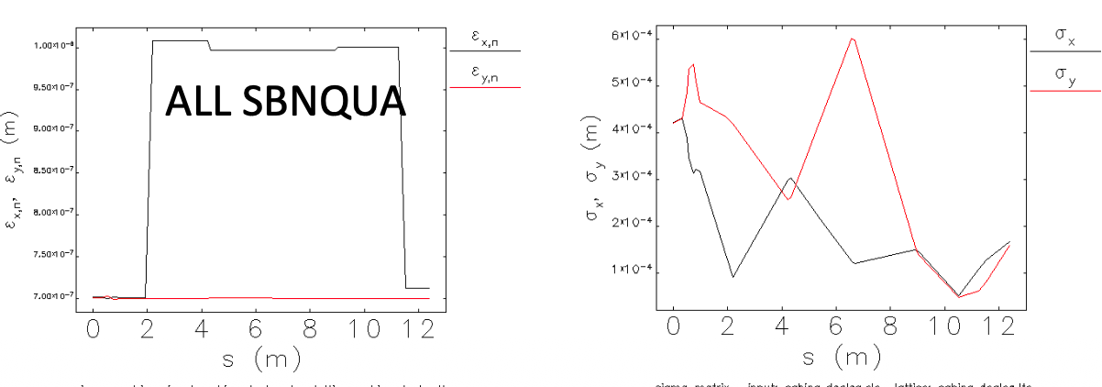
Dogleg transport:
Match PTL to nominal (Gilles WP) – Mark entrance reference in 1° dipole.
All SBNQ off - Transport to SBFLG02 & CENTER (right before the last dipole)
All SBNQ off– align SBNQUA01 X &Y using SBFLG01 & SBFLG02 (large in x for dispersion)
All SBNQ off– align SBNQUA02, SBNQUA03, in Y using SBFLG02 (only in Y because beam is large in X for dispersion)
All SBNQ off except SBNQUA01 (SBNQUA01 =nominal, -> beam contained in X, large in Y – align SBNQUA02, SBNQUA03, in X using SBFLG02 (only in X because beam is large in Y for defocusing of SBNQUA01)
Tune SBNQ 1,2,3 chicane to nominal setting dispersion off. Transport the beam to SBFLG03 with SBNQ 4,5,6,7 off. Center beam on SBFLG03, attempt transport to SBFLG04 with UM open. Set a straight line.
Align SBNQ 4,5,6,7 to the straight line using reference in SBFLG04
SBNQUA04,05,06
SBNFLG03
SBNFLG04
SBNFLG02
SBNFLG01

Slide 16
Dogleg transport:
Match PTL to nominal (Gilles WP) – Mark entrance reference in 1° dipole.
All SBNQ off - Transport to SBFLG02 & CENTER (right before the last dipole)
All SBNQ off– align SBNQUA01 X &Y using SBFLG01 & SBFLG02 (large in x for dispersion)
All SBNQ off– align SBNQUA02, SBNQUA03, in Y using SBFLG02 (only in Y because beam is large in X for dispersion)
All SBNQ off except SBNQUA01 (SBNQUA01 =nominal, -> beam contained in X, large in Y – align SBNQUA02, SBNQUA03, in X using SBFLG02 (only in X because beam is large in Y for defocusing of SBNQUA01)
Tune SBNQ 1,2,3 chicane to nominal setting dispersion off. Transport the beam to SBFLG03 with SBNQ 4,5,6,7 off. Center beam on SBFLG03, attempt transport to SBFLG04 with UM open. Set a straight line.
Align SBNQ 4,5,6,7 to the straight line using reference in SBFLG03, eventually 4
SBNQUA04,05,06
SBNFLG03
SBNFLG04
SBNFLG02
SBNFLG01

Slide 17
Thanks
G. J. Silvi
On behalf of the SPARC_LAB and SABINA collaboration

