Slide 1


Data Acquisition and Management for Machine Physics and Experimental Beamlines with EPICS
Presented by: Bob Dalesio

Slide 2
Requirements for NSLSII Beamlines / Machine
2008
Machine Protection from 60 beam loss monitors: 10 usecs
300 - BPM 10 kHz capture of 1 sec of data on MPS trip
90 Fast corrector Power Supply capture: 1 sec of data on MPS trip
Fast Orbit Feedback: not in scope – 300 Hz
6 Beamlines
  32 counter signals at 100 kHz
  50 motors

Slide 3
Delivered for NSLSII Beamlines / Machine
2015
Machine Protection from 60 beam loss monitors: 10 usecs
MPS from orbit excursion in pipe 60 – 300 BPMs, 100 usecs
300 - BPM 10 kHz capture of 1 sec of data on MPS trip
90 Fast corrector Power Supply capture: 1 sec of data on MPS trip
Fast Orbit Feedback at 1 kHz
6 Beamlines
  1 MPps Eiger Detectors
  250 motors – coordinated motion
  No Data Collection or Management

Slide 4
Machine Learning / Artificial Intelligence
Work shop in 2015 – Greg White
All beam related data at 1 kHz – continuously
  300 BPMs
  1000 Power Supplies
  98 RF Amplifiers
Beamlines - DAQ
  8 MPps Eiger Detectors
  Dozens of independent variables
  Track provenance form raq detector data through publication
SBIR Grant –
  Phase 1 demonstration data aggregation
  Phase 2 develop a Data Management Platform

Slide 5
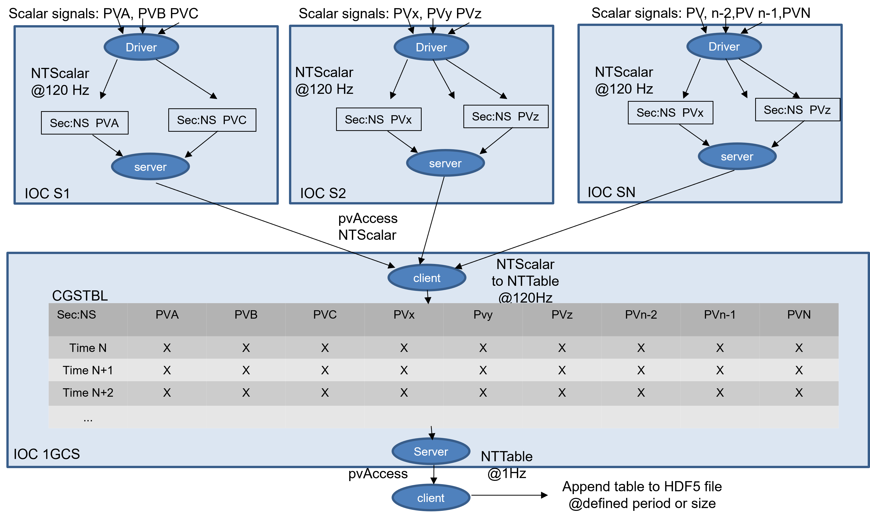
Prototype LCLS I – Data Aggregation – 2018
Data Collection
2k Beam Position Monitors
Each BPM with 3 PVs X, Y, Sum
Collected to a client
Aggregating the data into an
NT_Table
Written to an HDF5 file
Limited by packet collection to 320 Hz

Slide 6
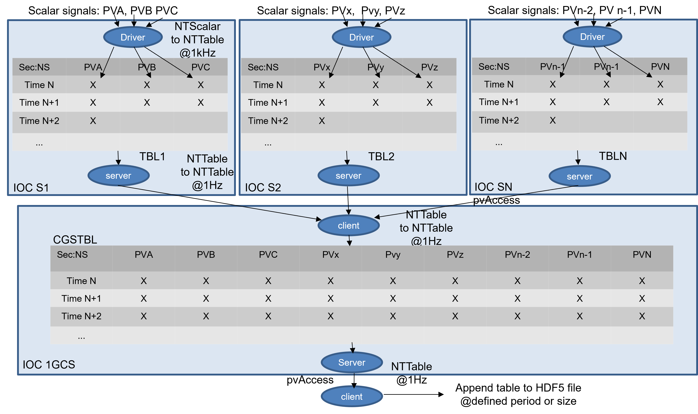
Phase 1 LCLS II – Data Aggregation - 2022
Data Collection
2k Beam Position Monitors
Each IOC collects BPM data
Into a table at 1 kHz
Tables are collected and
Merged at 1 Hz
Written to an HDF5 file

Slide 7
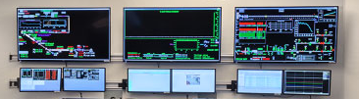
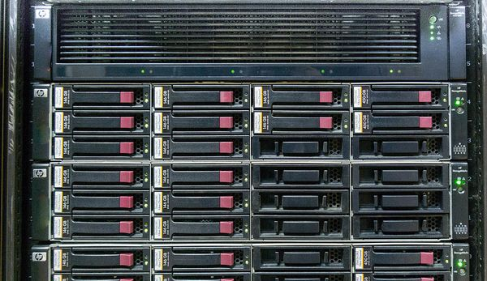
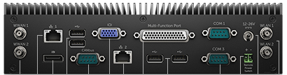

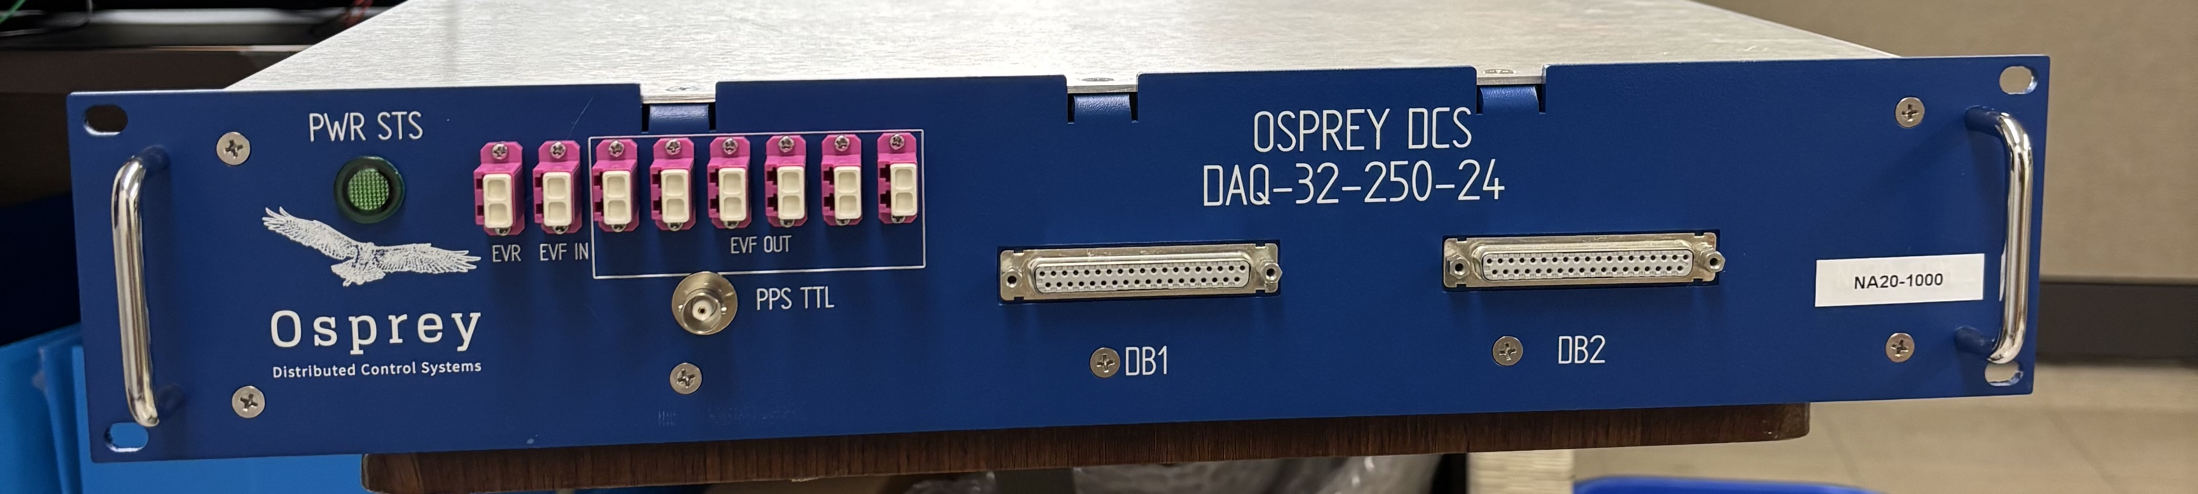
DAQ 250 kHz 24 bit
HW Architecture
Industrial I/O Controller
I/O Controller
Data Acquisition Computer
Console Server
Ethernet for EPICS Channel Access or pvAccess
Ethernet instrumentation bus
Ethernet pvAccess for DAQ
DAQ Chassis
Fault
Signals
Scanivalve Temperature Controller
PLC
Fast Deterministic Communication
Deterministic Timing Distribution Network
Master Pattern / EVENT Generator
IRIG-B

Slide 8
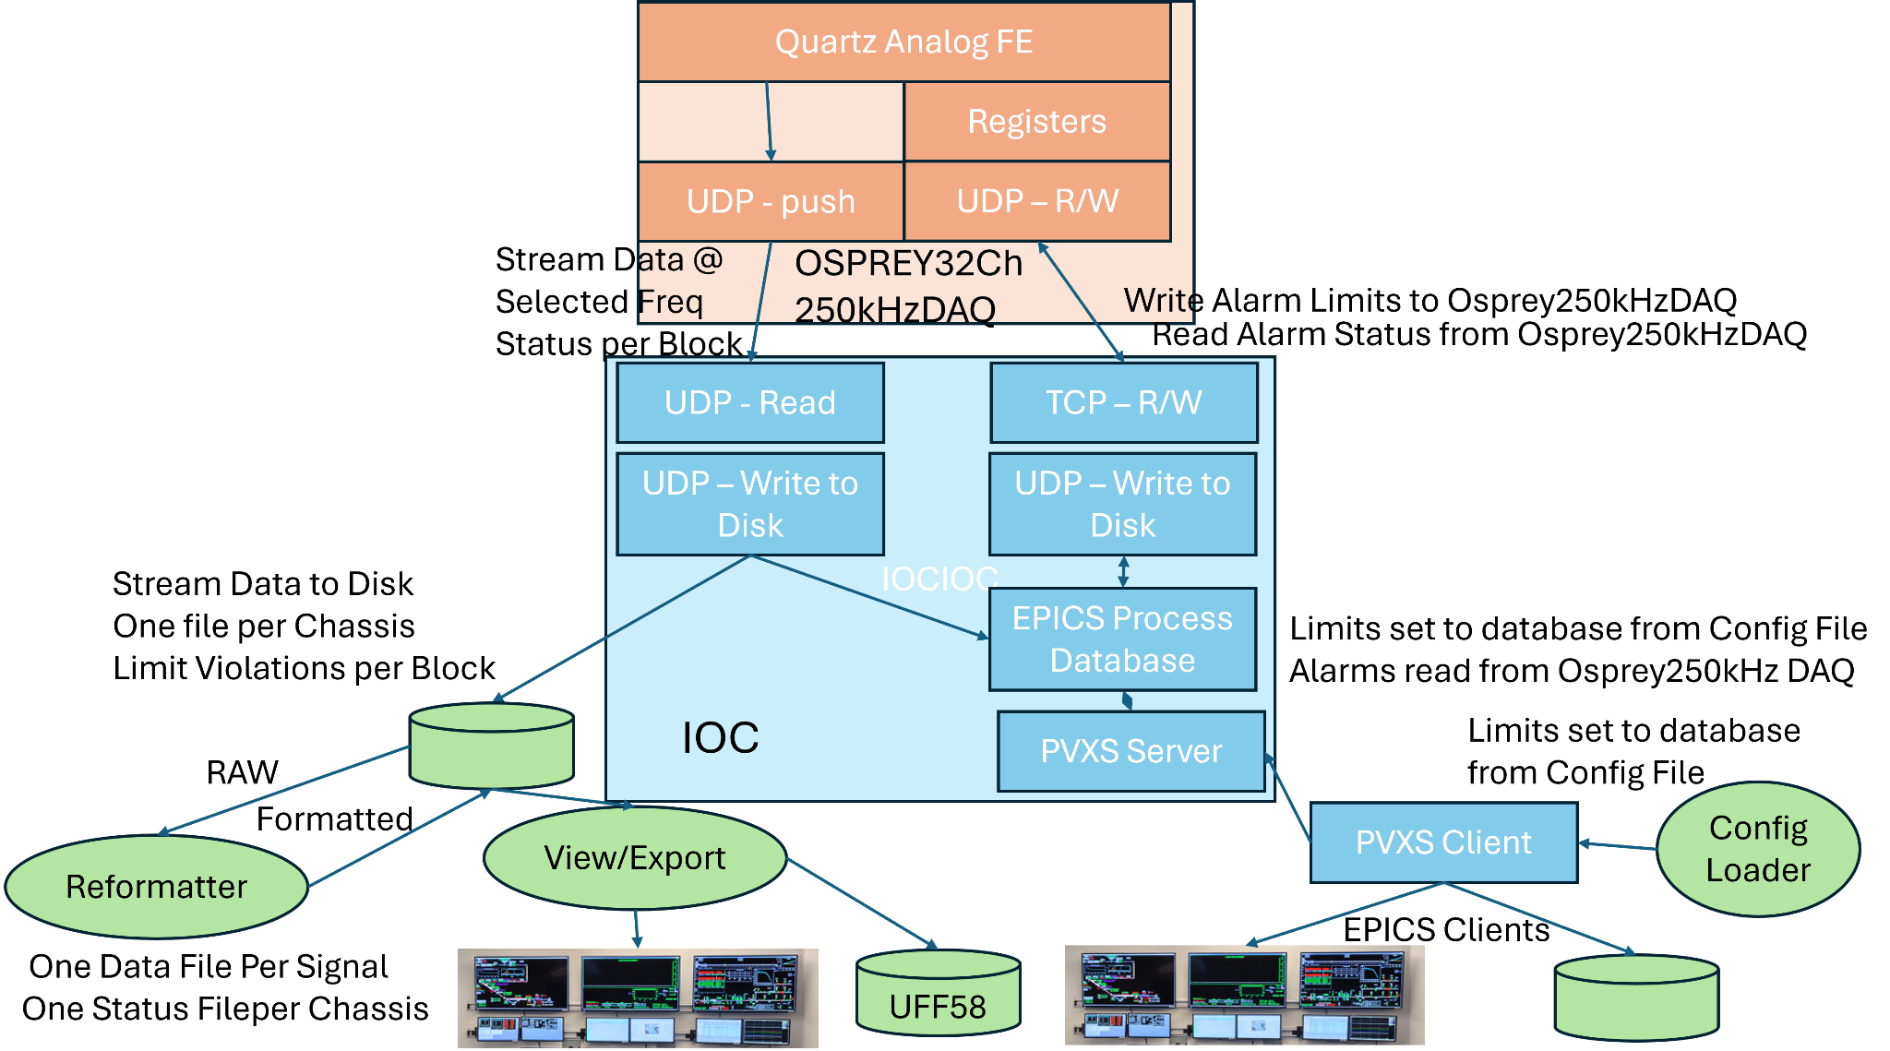
Quartz 250 kHz DAQ Application
From aggregation to application
Configuration, storage, manage, export

Slide 9
Quartz 250 kHz DAQ Application – collection
Data aggregation from LCLS II
Providew thoughput of 750 MBps

Slide 10
Quartz 250 kHz DAQ Instrumentation
Higher Speeds and Data Correlation
Require FPGA code in hardware

Slide 11
Quartz 250 kHz DAQ Application – configure
DAQ facility requires user
Configurations for each experiment

Slide 12
Quartz 250 kHz DAQ Application - view/export
Data viewing and export in different
Formats to feed to domain specific
Analysis codes

Slide 13
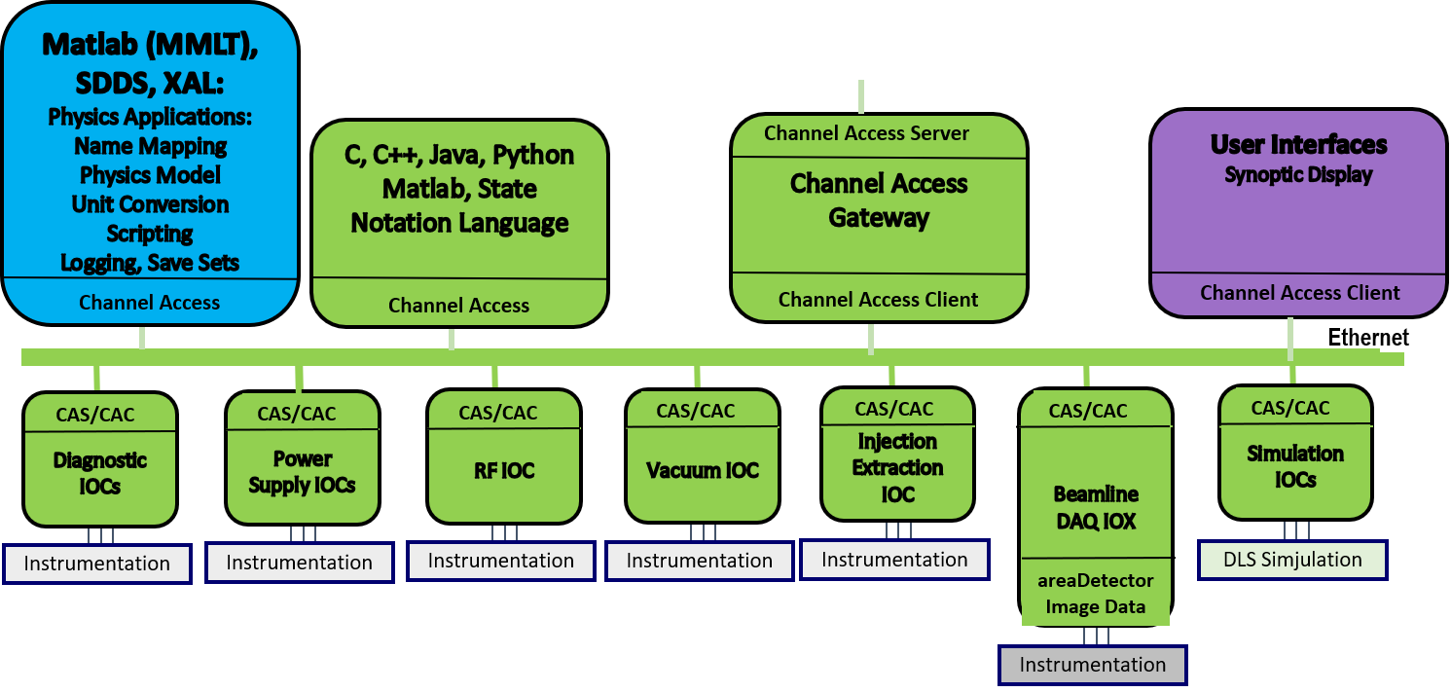
EPICS Architecture 2008

Slide 14
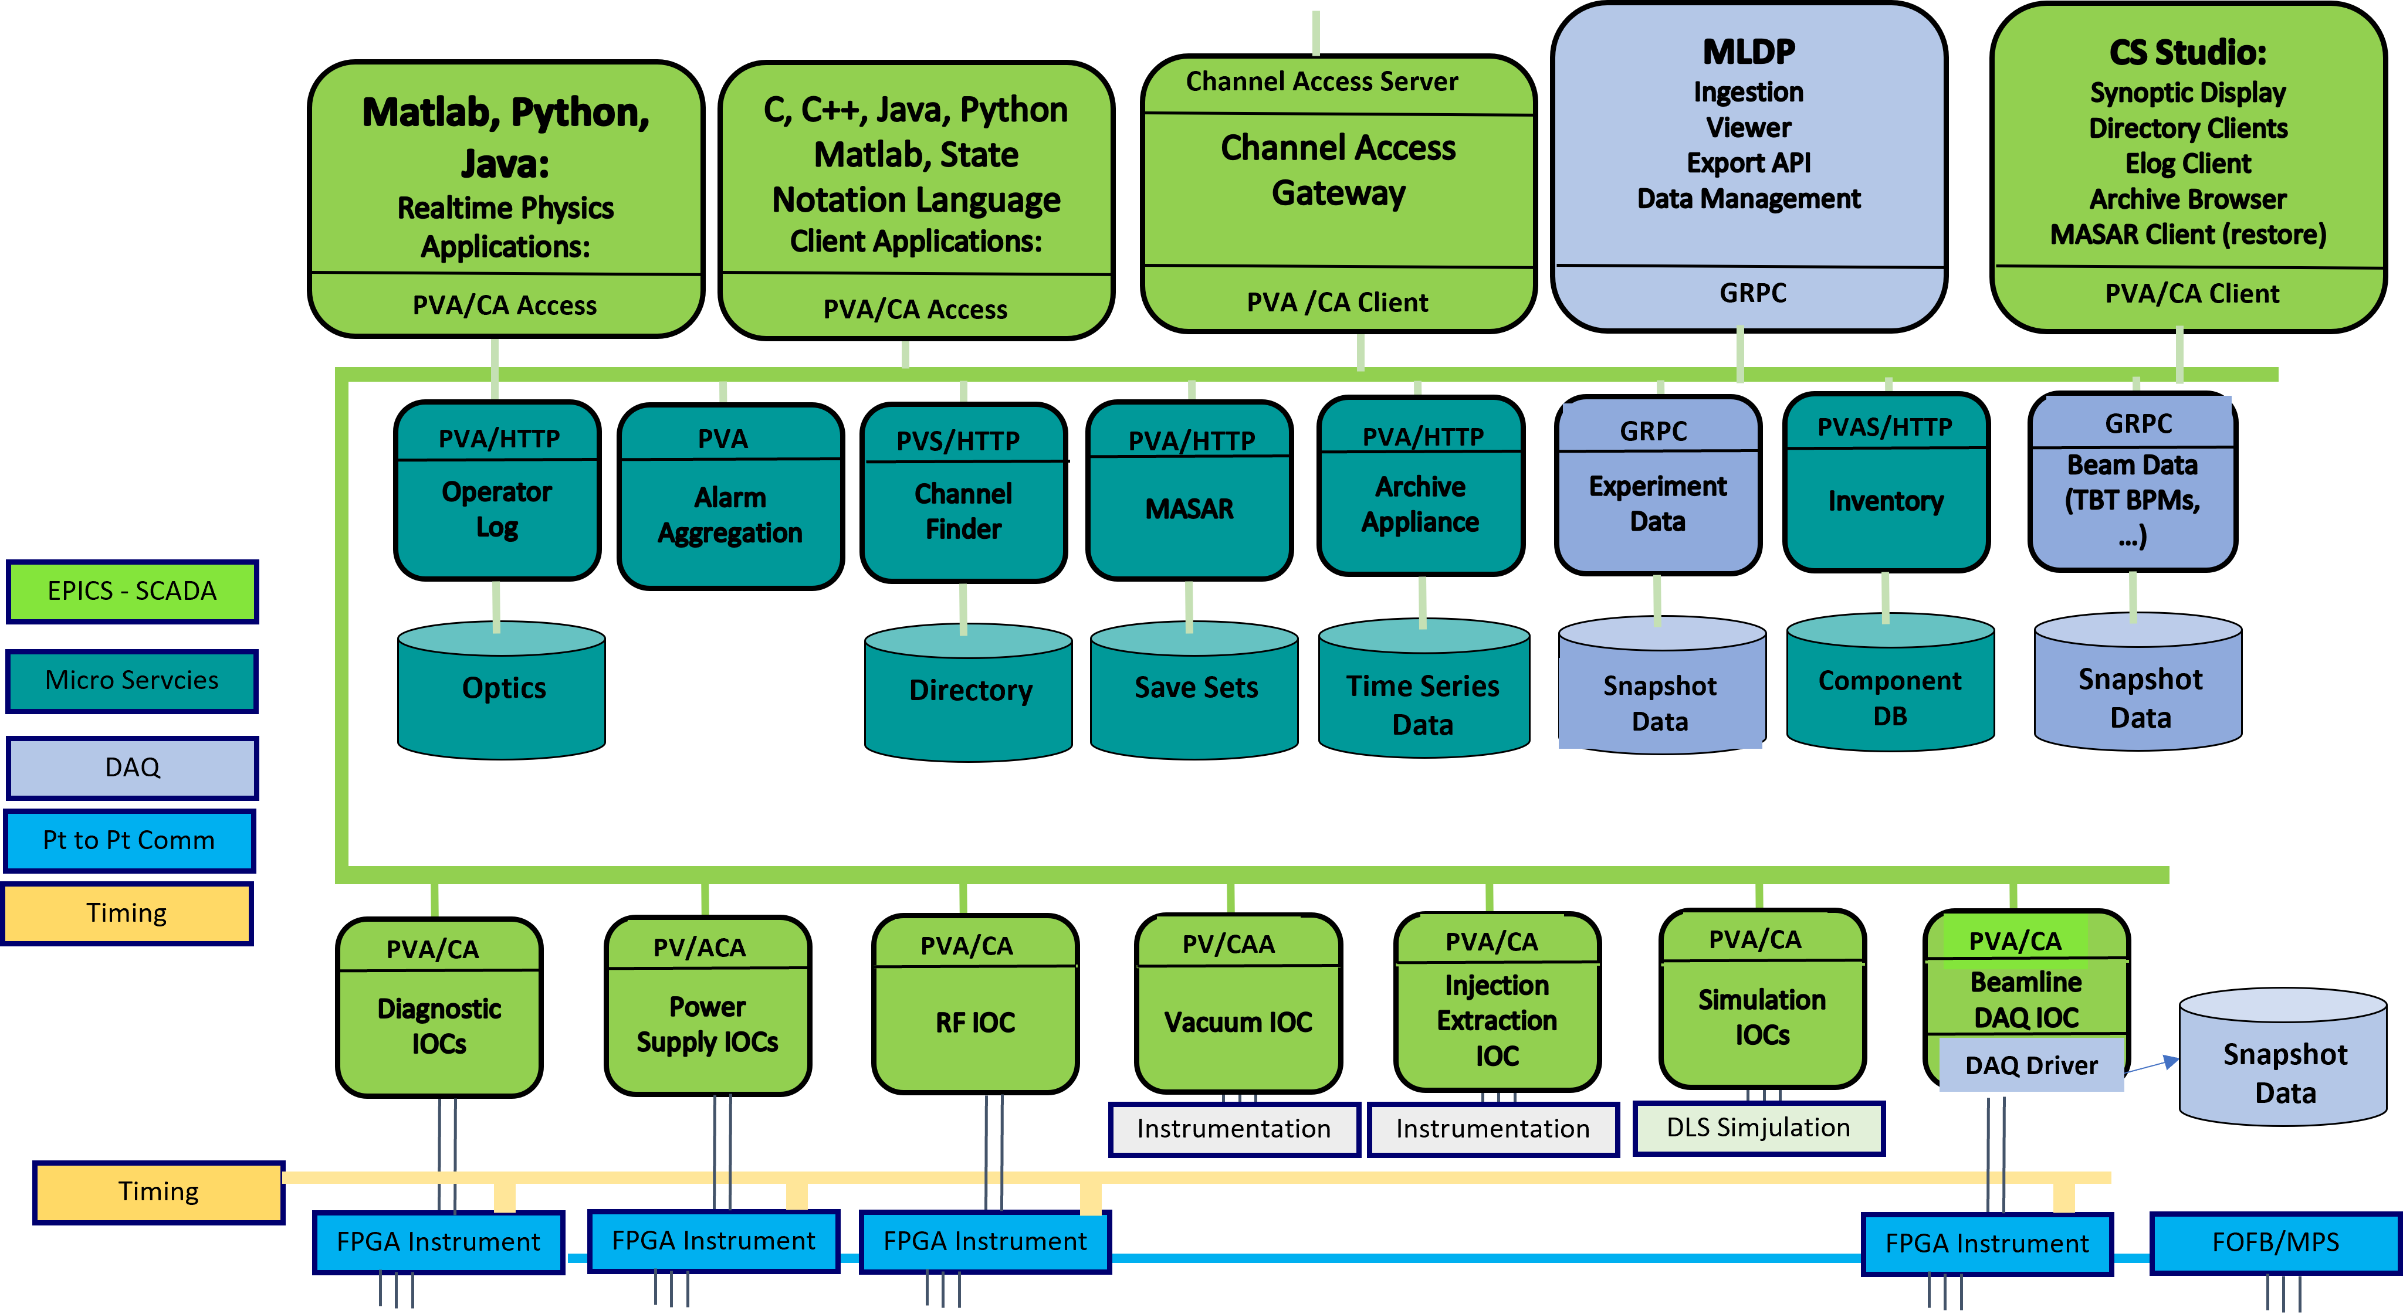
DAQ is Built on V7

Slide 15
MLDP – Objective
Provide full-stack support for data science and AI/ML applications at particle accelerator and large experimental physics facilities:
  Support for AI/ML applications from front-end, high-speed acquisition of heterogeneous, time-series data, through data archiving and management, to back-end analysis.
  Present a “data science ready” platform for data analysis and AI/ML applications in diagnosis, modeling, control, and optimization of these facilities.
  Offer data scientists and applications a consistent, data-centric interface to archive data, standardizing implementation and deployment of AI/ML algorithms to different operations configurations within the same facility, or between facilities.
Manage experimental data through its entire lifecycle:
  Data management from acquisition and archiving, through analysis and investigation, to release and final publication.
  Acquisition and archiving of heterogeneous data from experimental diagnostics (e.g., images, arrays, etc.) along with system configurations (e.g., scalars, tables), control system process variables, and any metadata required for provenance.
  Post-ingestion annotation of archived data with comments, data associates, calculations, and other artifacts relevant to experimental analysis.

Slide 16
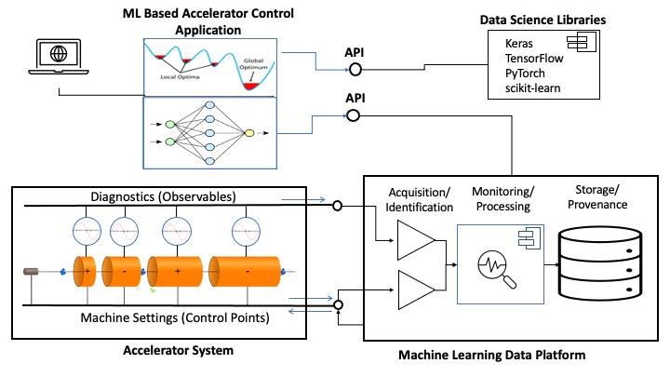
MLDP Overview
Motivation - Conceptual View
The Machine Learning Data Platform (MLDP)
has 3 primary functions:
  High-speed data acquisition (BSA).
  Archiving and management of heterogeneous, time-series data 500 MBps ingestion (not EPICS)
  Data Analysis: Broad query, annotation, and processing of archive data.
  (support of data science/ML/AI applications) 200 MBps stream out
Each functions is realized by a separate subsystem (component) supporting a category of use cases.
Conceptual diagram of Machine Learning Data Platform

Slide 17
Conclusions
Data Acquisition has swiftly evolved from 2008 to the present
Hardware and firmware is required to collect this data
  Time stamps, data sampling, data collection, real time viewing
  There is a small and growing community for open source in this area
Data storage, viewing and extraction is a good start.
Life cycle management and analysis must support the ability to read existing data sets, analyze them, store the resultant analysis along with all of the metadata required to track the provenance of the results.

Slide 18
Backup slides that detail out the MLDP

Slide 19
Data Correlation Is a Core Capability
Allow the device support to provide the timestamp from the Device.
Get the time stamp from the local time server NTP or PTP
Use the time stamp of the Record from which a value was read

Slide 20
MLDP Background
MLDP development is supported by the US Dept. of Energy (DOE), Office of Basic Energy Science (BES) under a Small Business Innovative Research (SBIR) grant.
A prototype MLDP was completed in Phase I (started in FY 2023):
  Demonstrated proof of principle.
  The component-based design originated in Phase I.
  Utilized many 3rd party systems and software (operational but inefficient).
SBIR Phase II awarded in Fiscal Year 2024 with completion in Aug. 2025
  Redesign and rebuild of “core services” with emphasis on performance (Year 1).
    Removed substantial amount of 3rd party systems (MongoDB now used for all archiving)
    Fully open source
  Support for archive annotation (Year 1, 2).
  Use case extensions (Year 2)
    Full archive annotations
    Ingestion stream processing,
    Algorithm Plugins

Slide 21
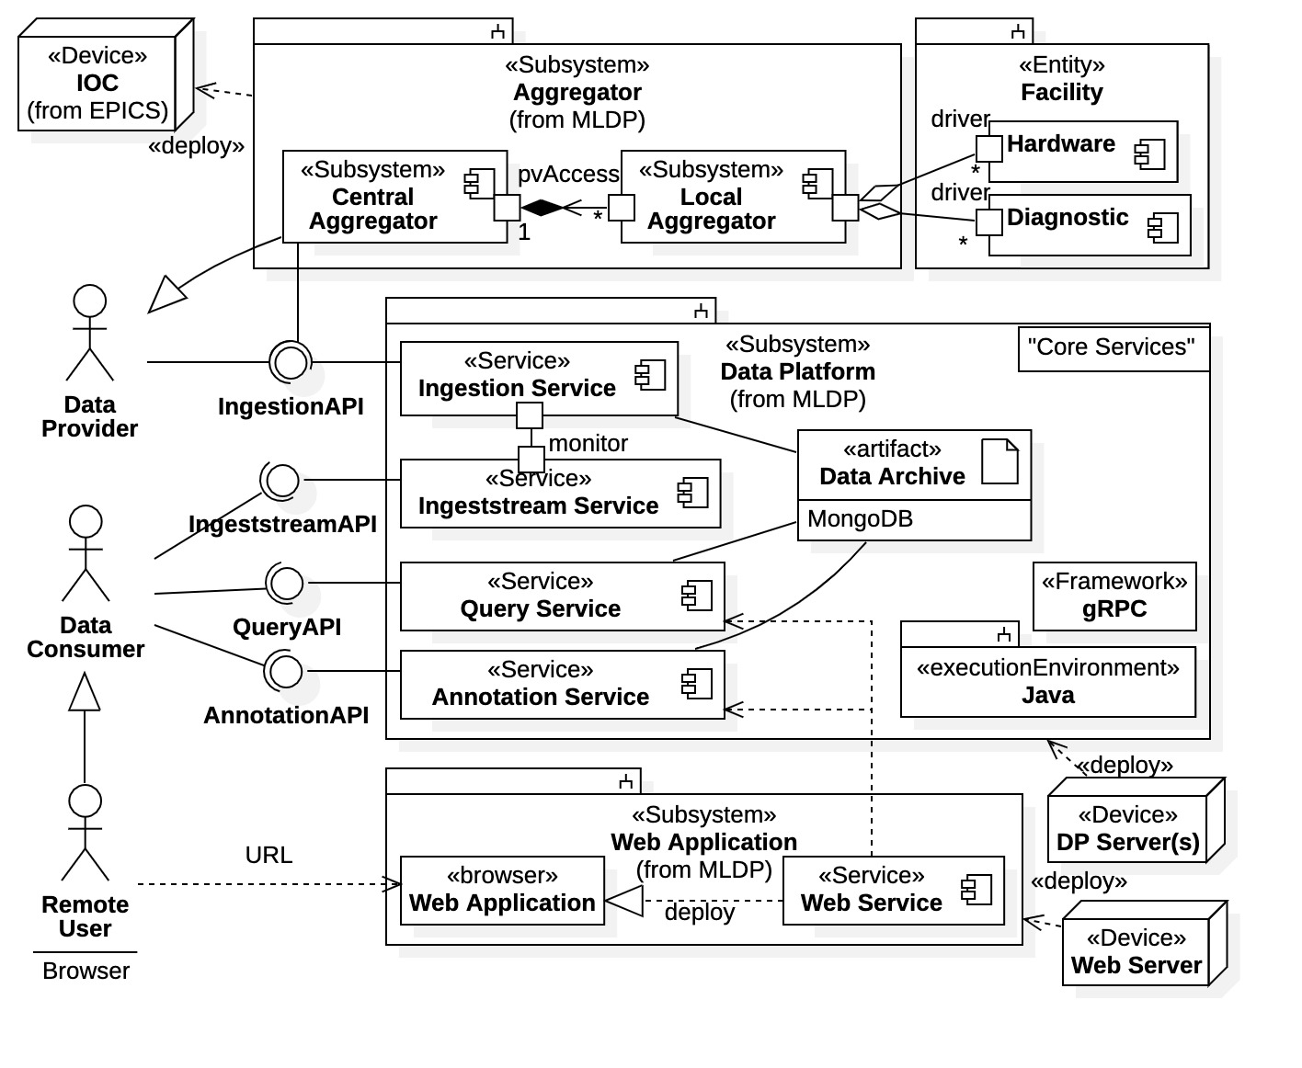
MLDP Components and Function
Components
  Aggregator – Frontend providing BSA, coalescing, and staging for data transport (M. Davidsaver).
  Data Platform – Service-based platform providing client interaction with gRPC APIs.
  Web Application – Provides remote access to the archive and a subset of Core Services.
  Language API Libraries – High-level client interaction with the Data Platform (not shown). Currently have a Java API Library.
Clients
  Data Provider – Any source of heterogeneous, time-series data complying to the API of the Ingestion Service. This includes the Aggregator component.
  Data Consumer – Any party interested in the MLDP data archive; this includes, facility engineers and physicists, beamline scientists, and applications.
  Remote User – A subclass of Data Consumer accessing the MLDP outside the facility network and able to perform analysis, annotations, etc.
MLDP composite diagram with client relationships

Slide 22
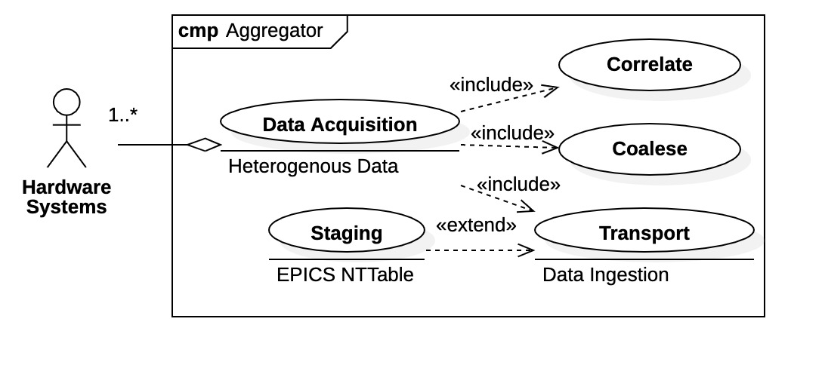
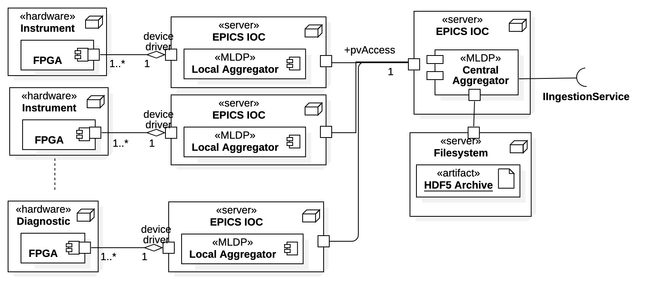
Aggregator Subsystem
Clients here are hardware systems
Aggregator performs synchronous, high-speed data acquisition and collection within EPICS control system.
Distributed system
Local Aggregators – proximal to hardware
  Collect and align local hetero data.
  May have multiple data sources.
  Transport to Central Aggregator.
Central Aggregator
  Coalesce all aggregated data.
  Stage data as NTTable “snapshots”.
  Transport to Data Platform via API.
Aggregator use cases
Aggregator system architecture

Slide 23
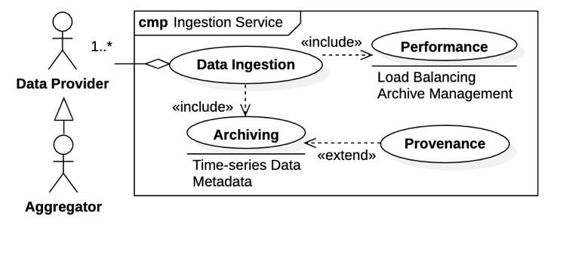
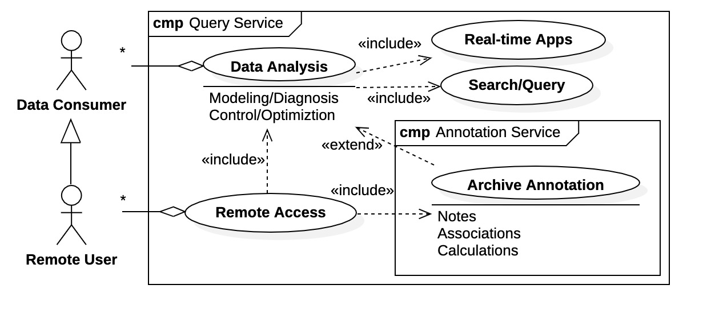
MLDP Core Services
Data Platform- Service Model
Clients are generically divided into
Data Providers - populate data archive (e.g., Aggregator)
Data Consumers - utilize data archive
Ingestion Service use cases
The Data Platform Core Services manage the Data Archive and are the primary interaction point for clients.
The Data Platform is a standalone system, independent of EPICS.
Fundamental components implemented as services
  Ingestion Service – clients are Data Providers that supply data to the Archive.
  Query Service – clients are Data Consumers that interact with the Data Archive.
    Engineers, data scientists, physicists, applications, remote users, etc.
  Annotation Service – clients are Data Consumers that supply ”value added” information to the Data Archive.
Query and Annotation Service use cases
Data Platform use cases as seen by clients

Slide 24
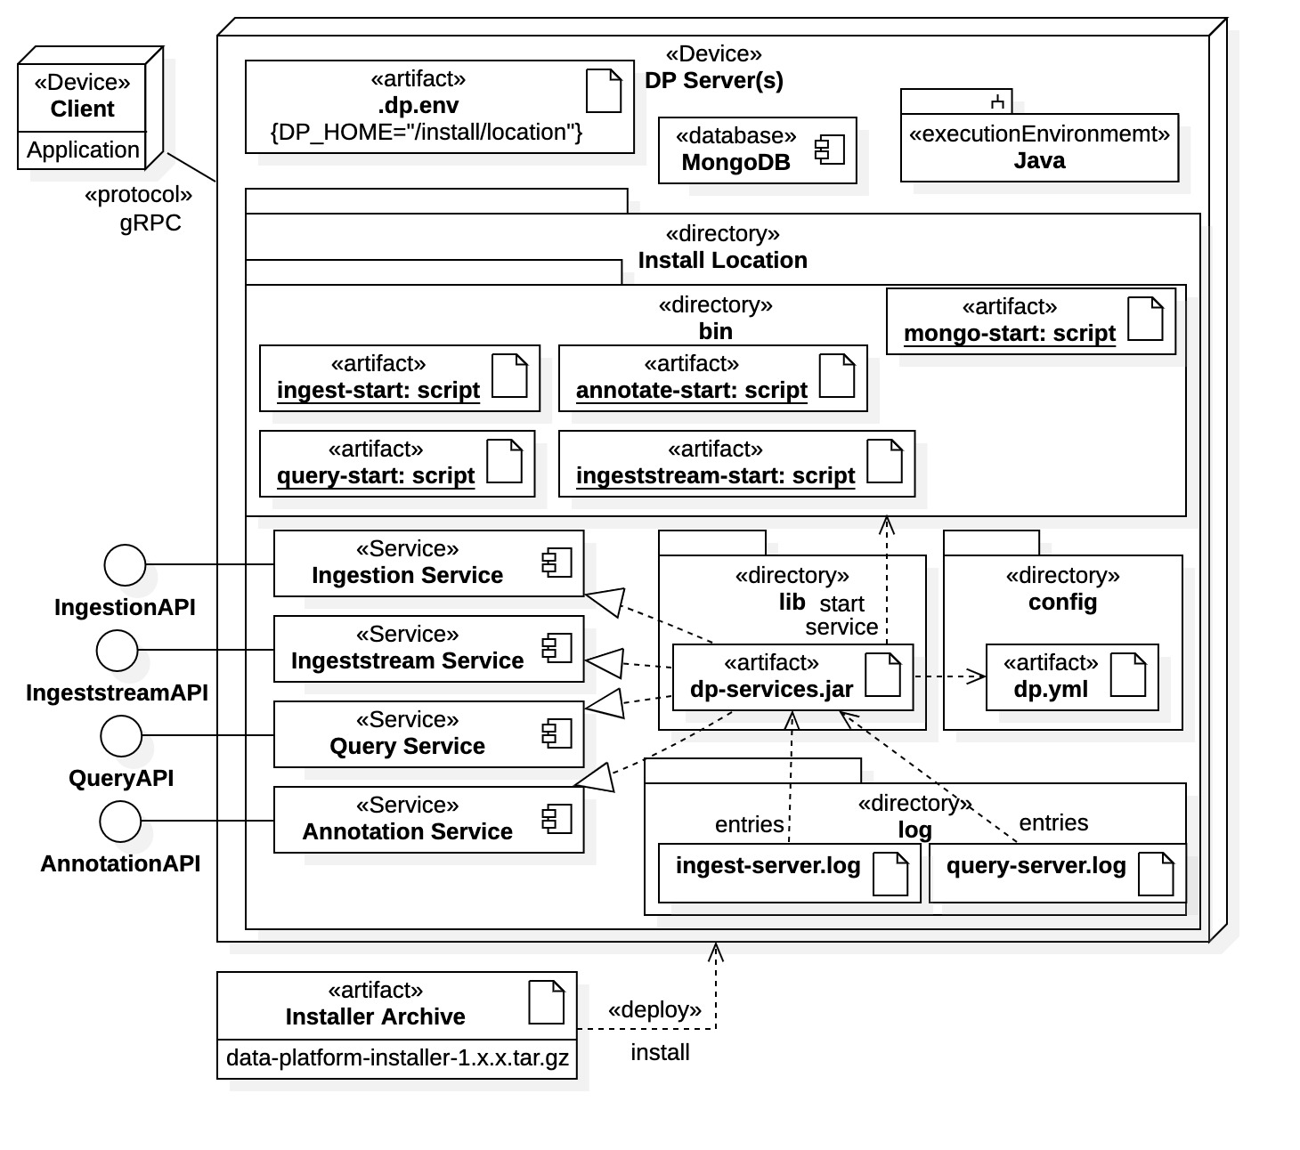
Data Platform Subsystem
Data Platform provides all archive management and access via separate services.
  Data provenance is maintained with metadata and annotations.
Ingestion Service
  Ingests correlated, heterogeneous data.
  From Aggregator or other data source recognizing ingestion API (~500 Mbps).
Query Service
  Supplies correlated, heterogeneous data and archive metadata (~200 Mbps).
Annotation Service
  Allows centralized management and processing of post-ingestion data.
  Comments, associations, calculations, etc.
Ingestion Stream Service
  Access to ingestion stream data for real-time applications (under development).
Data Platform installation and deployment

Slide 25
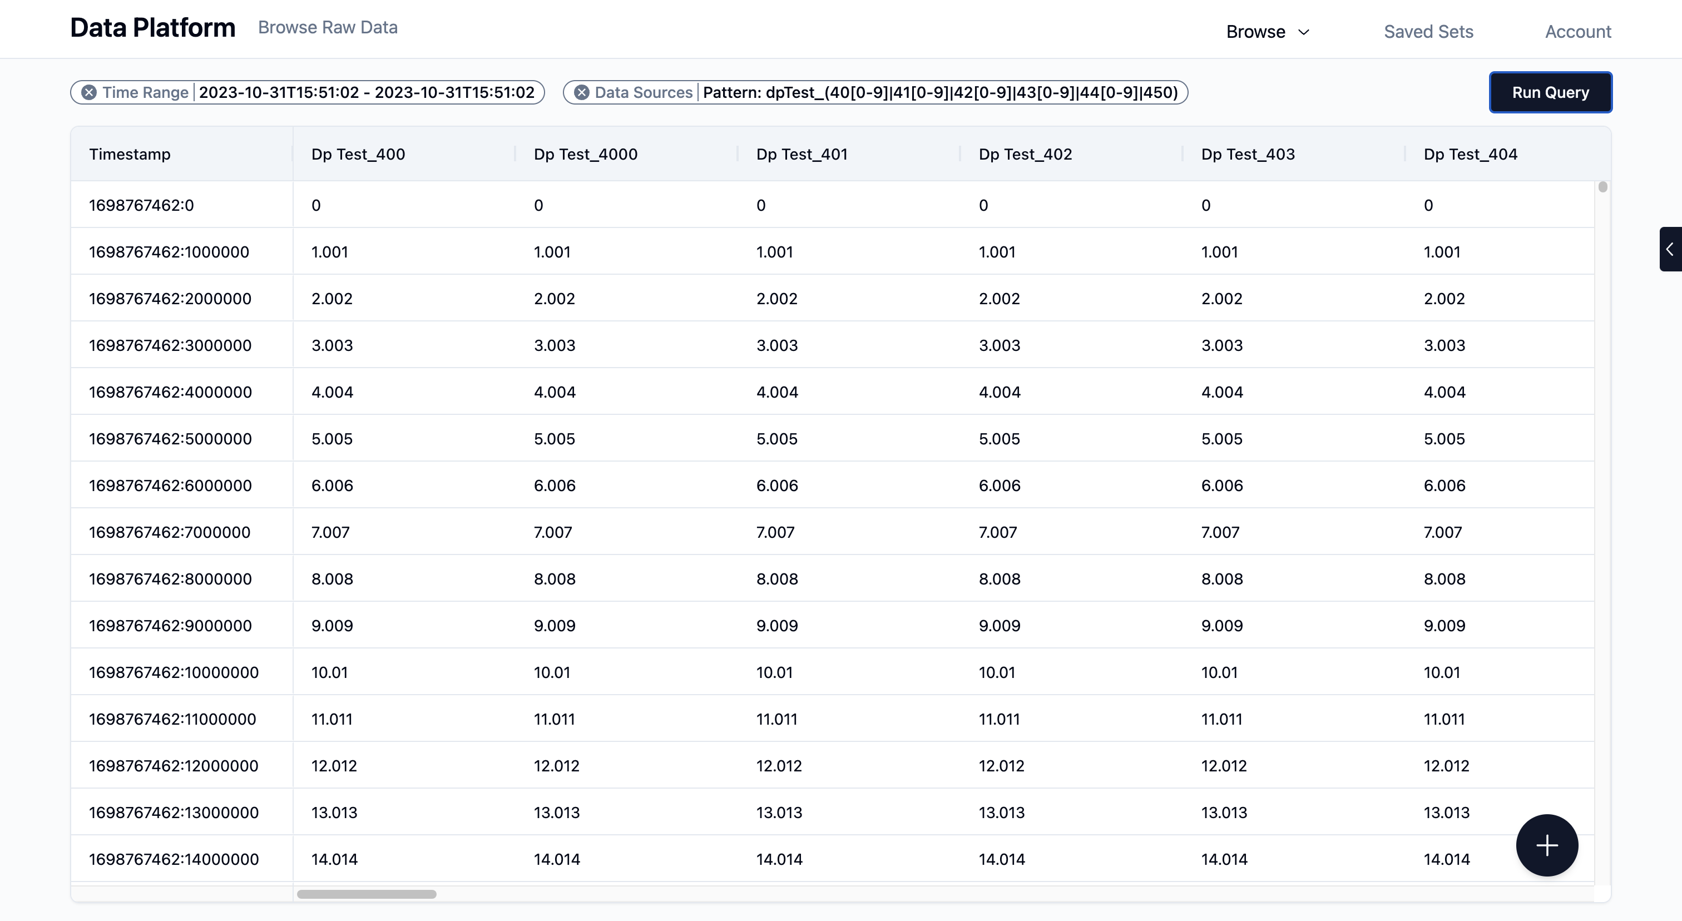
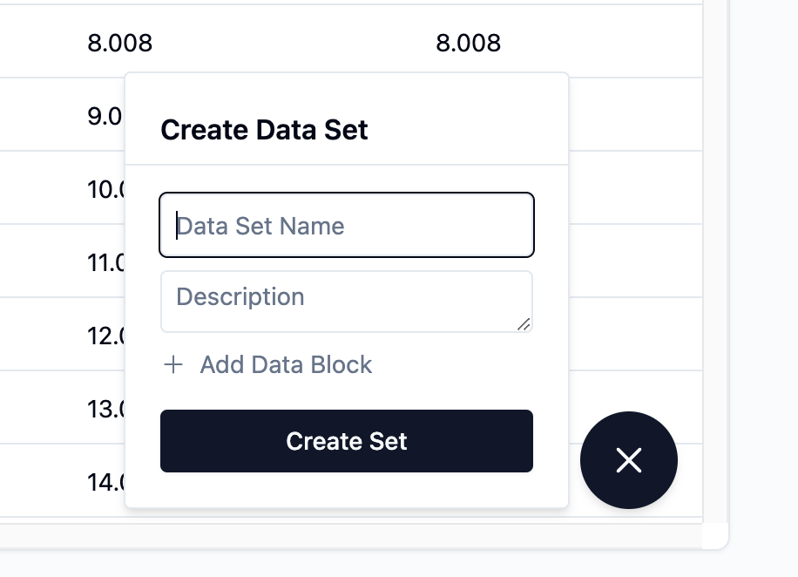
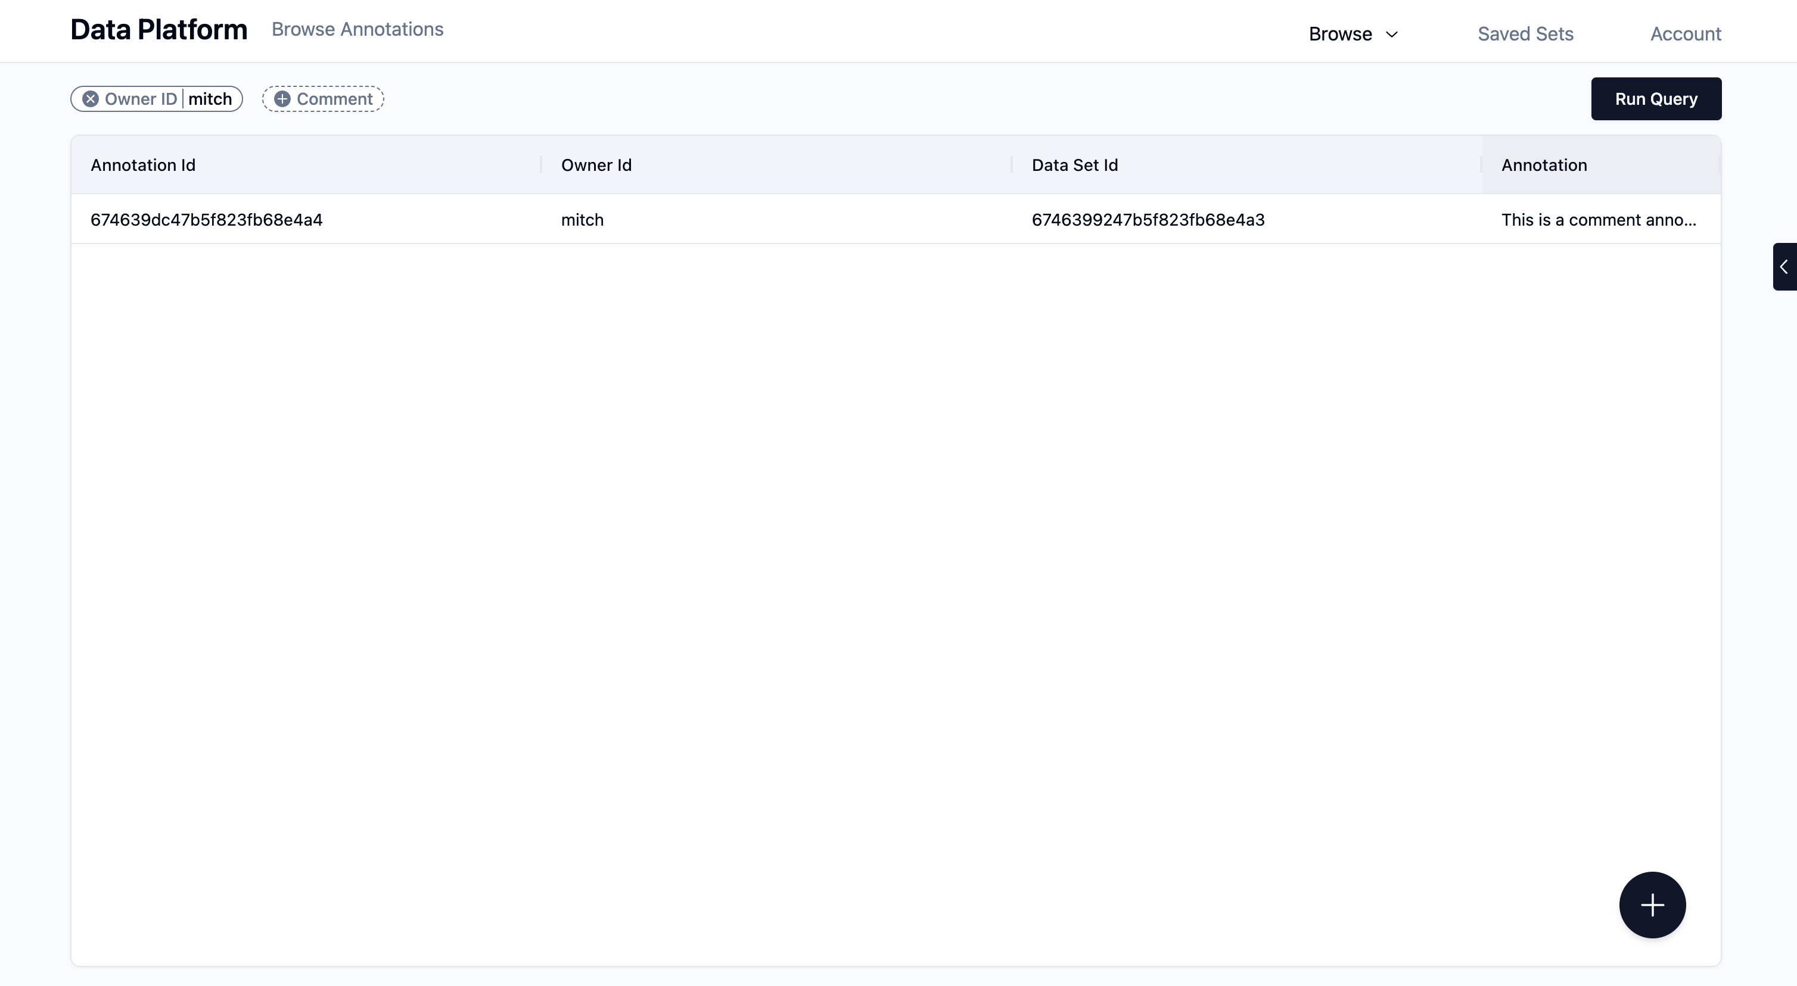
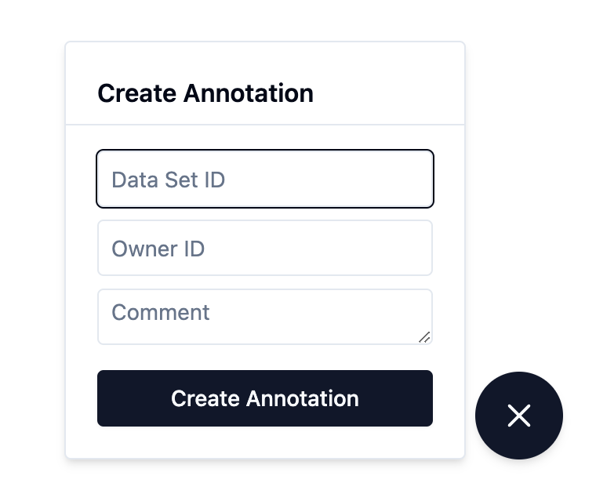
Web Application
Remote access and interaction with Data Platform via a web browser.
  Hosted on separate server and accessed via an URL.
  Provides subset of Data Platform features appropriate for browser.
  Currently supports time-series and metadata queries, comment annotations, data exporting.
  Plan to provide basic data science features such as time-series visualization, statistics, etc.
Annotations apply to ”datasets” within the archive.
Web Application user interface screen shots

Slide 26
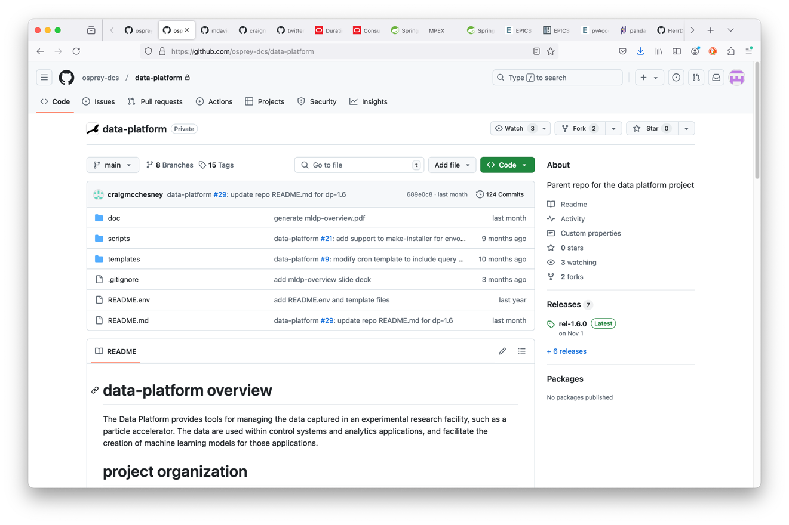
Data Platform Installation and Deployment
The Data Platform is a fully independent subsystem deployable from an installation archive available at https://github.com/osprey-dcs/data-platform
Install Java locally (version 21 or greater).
Install MongoDB 7.0 (free Community Edition) and create administrator (admin) account.
Download and unzip the Data Platform installation archive.
Set the DP_HOME environment variable to the local installation directory.
  Or set DP_HOME in home directory file ~/.dp.env for user account
Start Data Platform services using scripts provides within installation
Data Platform main repository page
Installation process is fully documented on home page.
Release installation archives

Slide 27
Data Platform API
Data Platform has 2 communication methods.
  Direct gRPC communications (via the Communications Framework)
  High-level language API libraries
    Java API Library is available (under development).
    A Python API Library is planned.
The Data Platform Communications Framework is based upon gRPC
Direct communications with the Data Platform
  Install the gRPC communications framework at https://github.com/osprey-dcs/dp-grpc
  Build the framework locally into desired programming language using Protocol Buffers compiler “protoc”.
    The Core Service client APIs are available locally as programming language classes or interfaces.
    The Core Service RPC messages are available locally as programming language classes.
  Build client applications using Communications Framework APIs and (some) gRPC library components (language dependent).

Slide 28
DP Communications Framework gRPC and Protocol Buffers Background
gRPC
An RPC framework (built by Google) using HTTP2 as the underlying transport mechanism.
  gRPC libraries are open source and available for most programming languages and hardware platforms.
  gRPC provides standard “unary” RPC calls and “data streaming” extensions.
Protocol Buffers (“Protobuf”)
Defines RPC messages and interfaces using gRPC as the communications protocol.
  Open source and originally developed by Google.
  RPC messages and interfaces defined in “proto” meta language, then compiled into standard programming languages using the “protoc” Protobuf compiler.
  Provides the data serialization for exchanged messages (quite efficient).
  Clients and service can be built in different programming languages.
The gRPC/Protobuf communications framework facilities Data Platform standalone independence and flexibility.

Slide 29
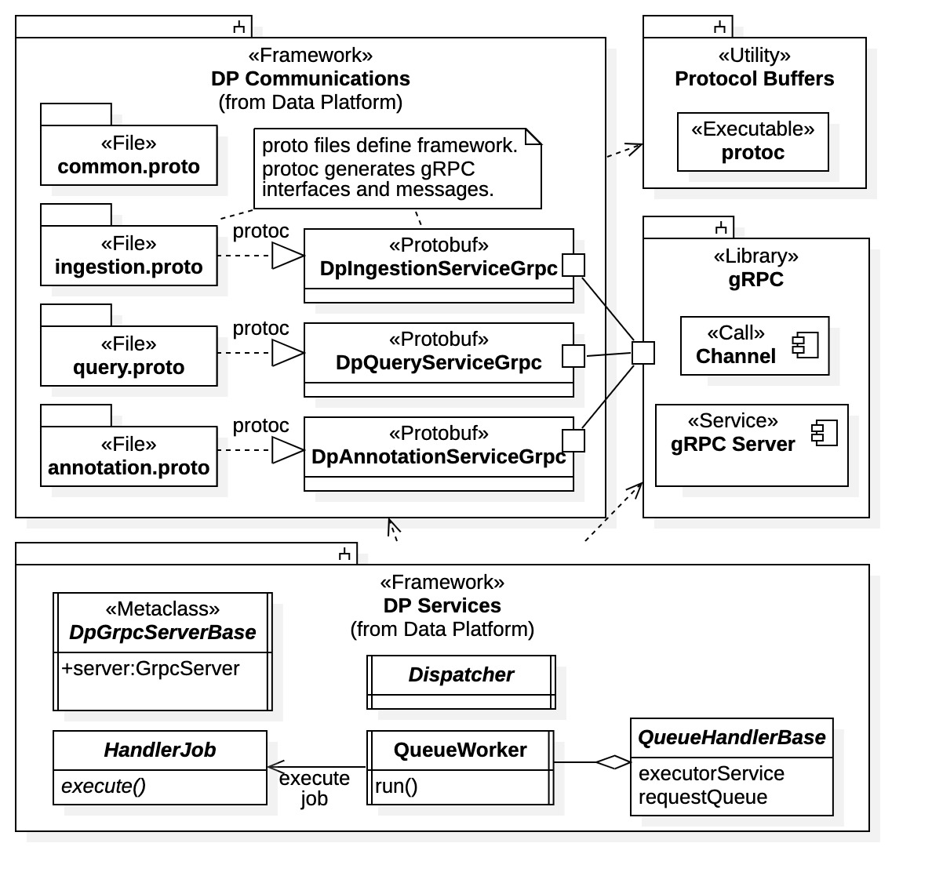
Data Platform API
Data Platform gRPC Communications Framework
Communications Framework is defined in 4 Protocol Buffers “proto” language files:
  common.proto – common messages used by framework.
  ingestion.proto – Ingestion Service API definition and messages specific to Ingestion Service.
  query.proto – Query Service API definition and messages specific to Query Service.
  annoatation.proto – Annotation Service API definition and messages specific to Annotation Service.
  ingest_stream.proto (not shown) – under development. Ingestion Stream Service API.
Data Platform communications framework with Core Services and gRPC relationships

Slide 30
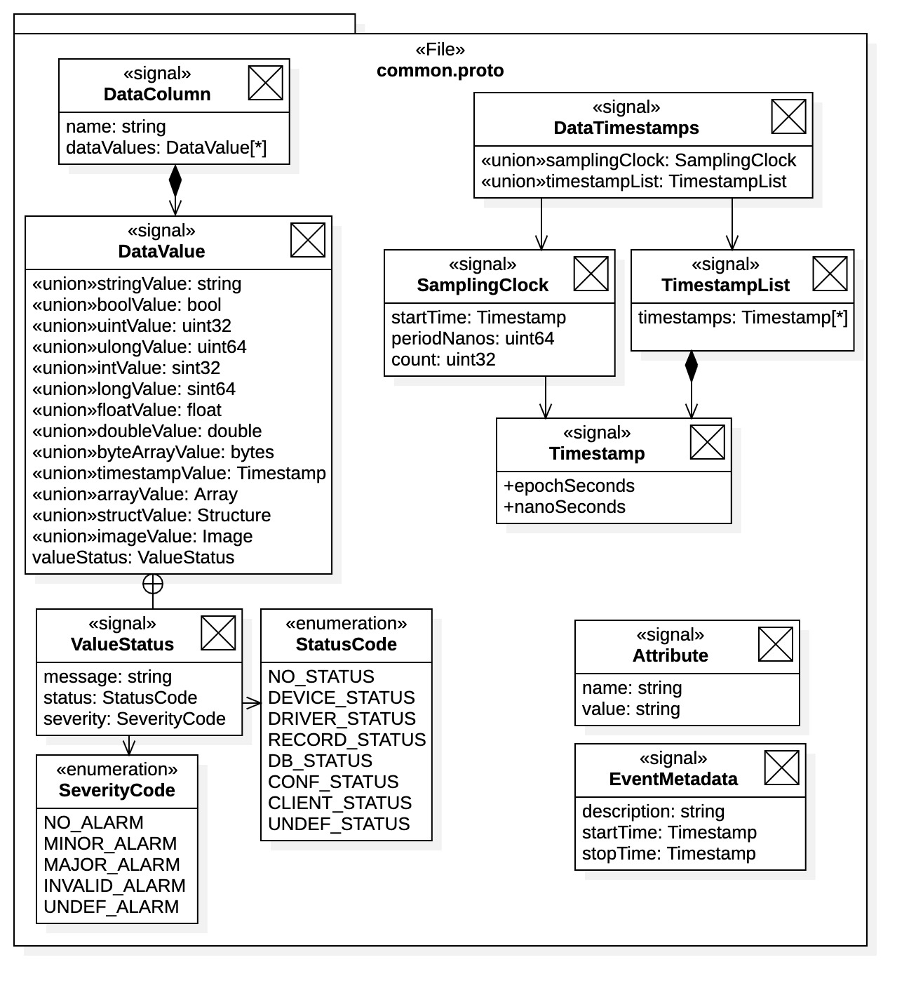
Data Platform gRPC API
Heterogeneous Data Support in common.proto
The API defines message DataValue to represent a heterogeneous data value for use in the ingestion and query interfaces
  Simple scalar data types
  Complex types including multi-dimensional arrays, data structures, and images.
  Values can optionally include ValueStatus providing status information captured from the control system.
DataValues are aggregated into a DataColumn message representing a sampling process.
Timestamps for the process are provided as separate DataTimestamp messages.
  Sampling clock for multiple columns
  Explicit timestamp lists for multiple columns
communication framework common messages

Slide 31
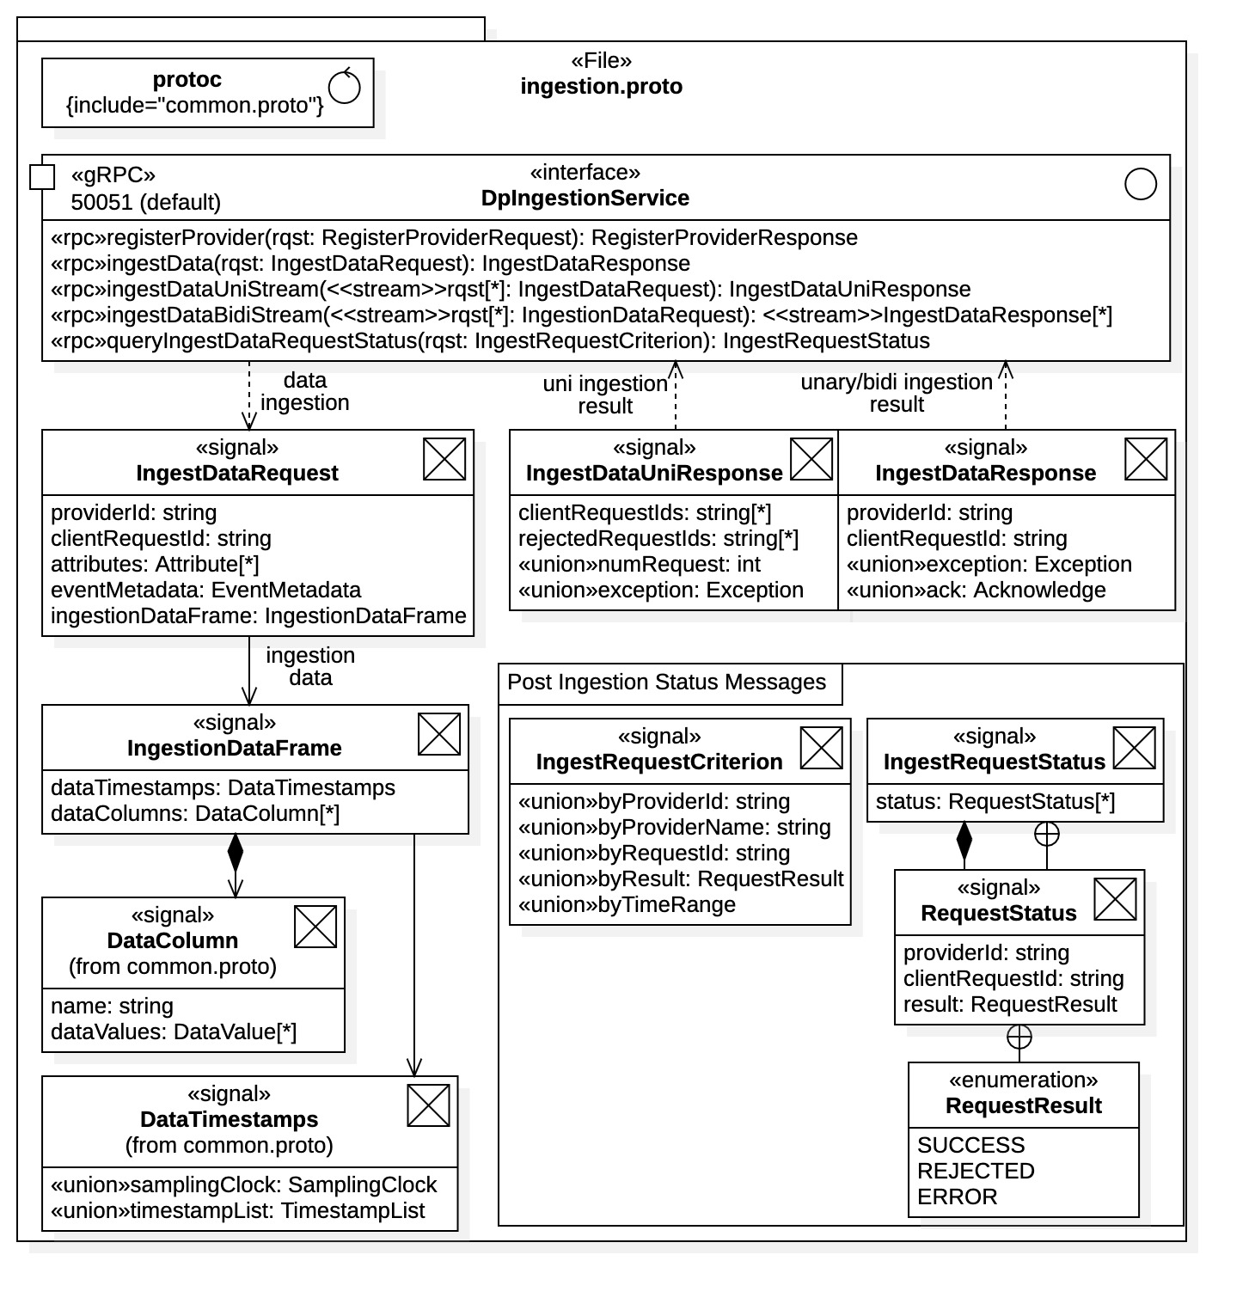
Data Platform gRPC API
Ingestion Service API in ingestion.proto
The DpIngestionService interface defines all RPC operations for the Ingestion Service.
  Data Provider registration (data provenance)
  Unary data ingestion
  gRPC streaming data ingestion
Data ingested as IngestionDataRequest messages containing IngestionDataFrame message.
  Correlated blocks of time-series data (IngestionDataFrame) and metadata
  Analogous to the EPICS NTTable type.
IngestionDataFrame message
  Aggregation of DataColumn messages
  Timestamps for data columns (sampling processes)
Ingestion Service gRPC interface and messages

Slide 32
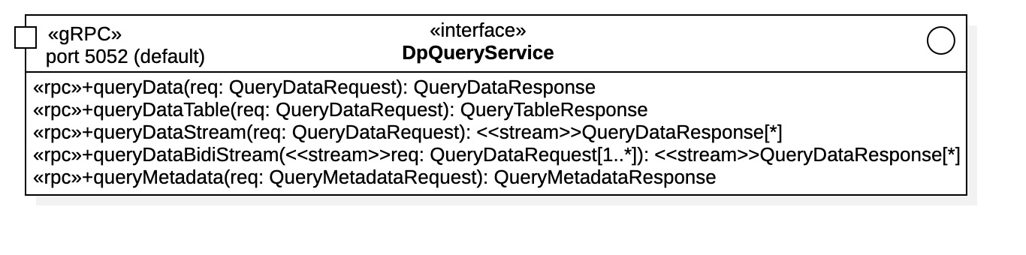
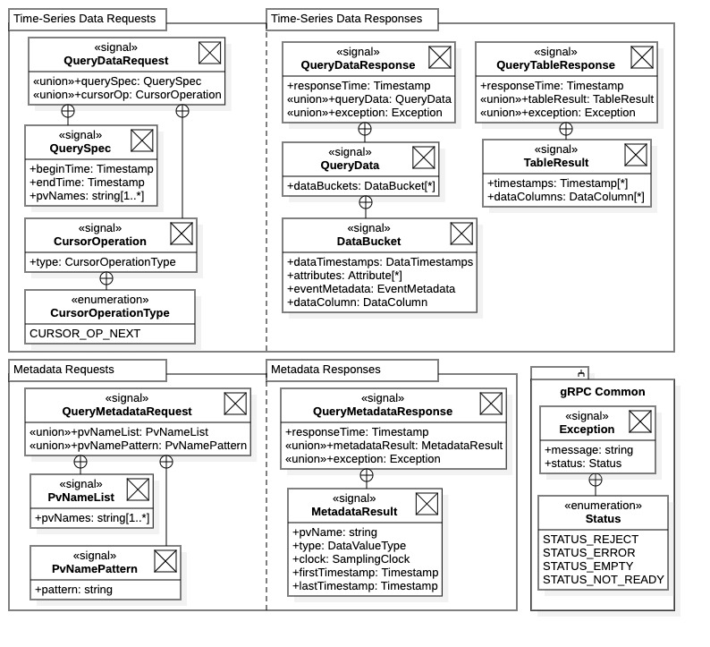
Data Platform gRPC API
Query Service API in query.proto
Query Service gRPC communications framework interface
The DpQueryService interface defines all RPC operations for the Query Service.
  Time-series data table request (unary, size limited)
  Time-series raw data request (streaming, unlimited)
  Metadata query requests
Time-series query response
  QueryDataResponse – raw “data bucket” messages
  QueryTableResponse – tabular format
For performance consideration, raw data is available as a streaming operation from the Query Service.
As ”data buckets” associated with MongoDB storage.
Data table assembly done on client platform to offload Query Service processing.
Query Service communications framework messages

Slide 33
Data Platform Java API Library
Available at https://github.com/osprey-dcs/dp-api-common
  Soon to be renamed (more appropriately) dp-api-java.
Java API Library communications with the Data Platform services
  Install Data Platform and start desired service(s).
  Download and install gRPC communications framework dp-grpc.
    Do a Maven install (“mvn install”)
  Download and install the Java API Library dp-api-common (java-api-java)
    Or build Java API Library into a JAR file in Java class path (“mvn package”).
  Library resources are available as Maven dependency or JAR in class path.

Slide 34
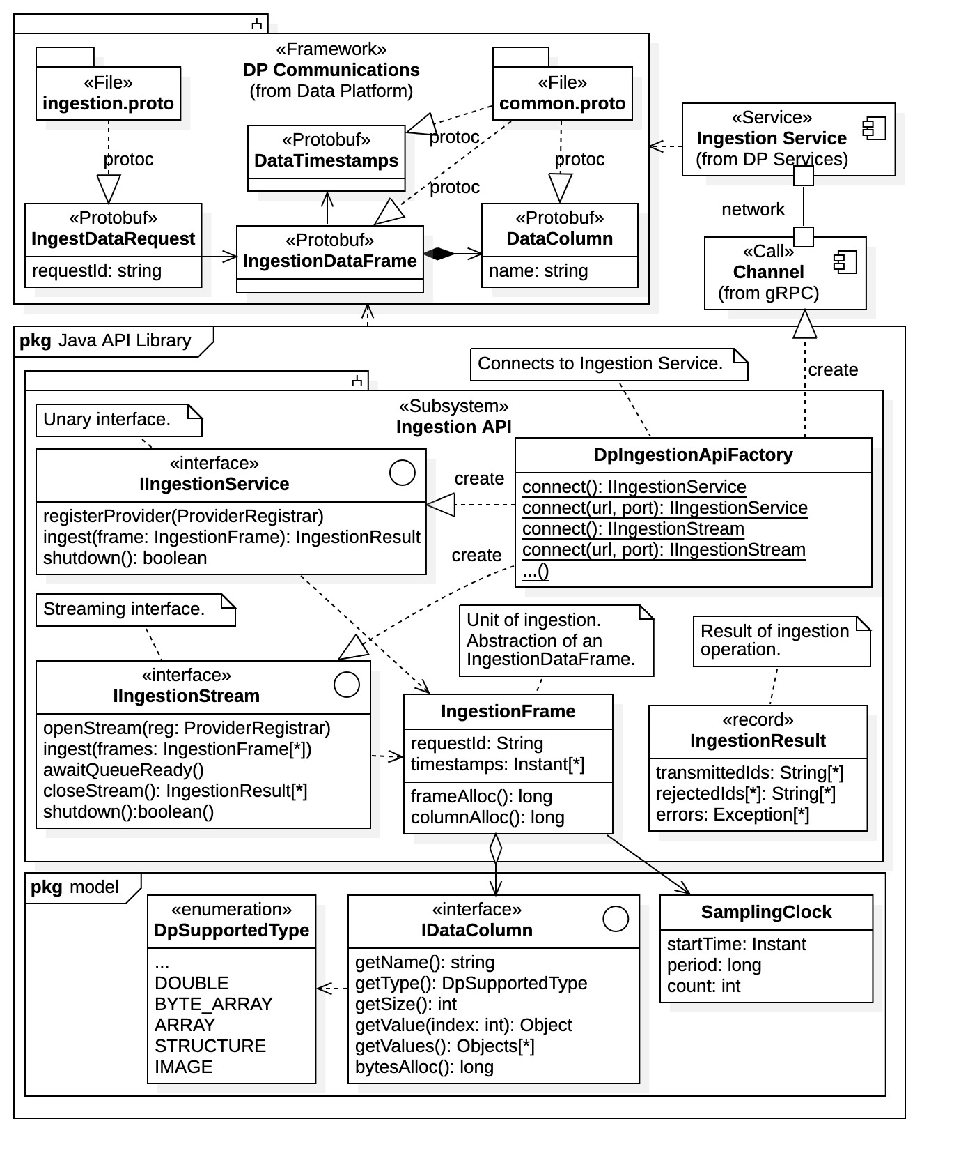
Data Platform Java API
Ingestion Service API
Ingestion operations are available through 2 interfaces:
  IIngestionService – Unary single-frame ingestion
  IIngestionStream – Multi-frame streaming ingestion
Connection factory DpIngestionApiFactory provides both interfaces through static methods.
  Allows a variety of connection options include default connect().
All ingestion is performed using an IngestionFrame as the unit of ingestion.
  Populated by clients (Data Providers) with time-series data, timestamps, and any metadata.
  Analogous to EPICS NTTable type (allows direct conversion).
All APIs within the Java API Library are obtained through “connection factories.” Connect factories provide clients a variety of connection options to the Data Platform services, including the default connection defined in the library configuration file.
Java API Library Ingestion API

Slide 35
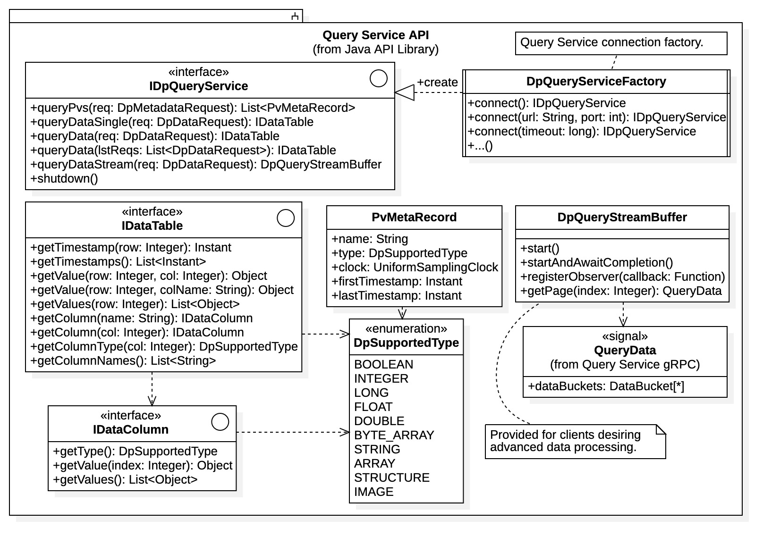
Data Platform Java API
Query Service API
Query operations are available through a single interface:
  IQueryService – All time-series data requests and metadata requests
  Connection factory DpQueryApiFactory provides interface.
Time-series data requests
  Request builder DpDataRequest class used to create request (not shown).
  Data returned as data tables (interface IDataTable)
  Raw data (i.e., “data buckets”) from Query Service is assembled into tables on client platform within library.
  Low-level DpQueryStreamBuffer also available.
Metadata Requests
(only “PV requests” currently available)
  Returned as metadata records specific to the metadata type.
Java API Library Query Service interface

Slide 36
Summary
Aggregator system (front end)
  Hardware facing
  Requires site-specific installation
Data Platform
  Independent system for data management, provenance, and processing.
  gRPC communication framework for direct communication.
  Building programming language API libraries for high-level communication.
Web Application
  Provides remove users a subset of MLDP archive interactions using a standard internet web browser.
Project Status
  Building calculations support for Annotation Service.
  Initial development of Ingestion Stream Service and plugin framework.
  Advanced ”data simulator” constructed for load testing.

Slide 37
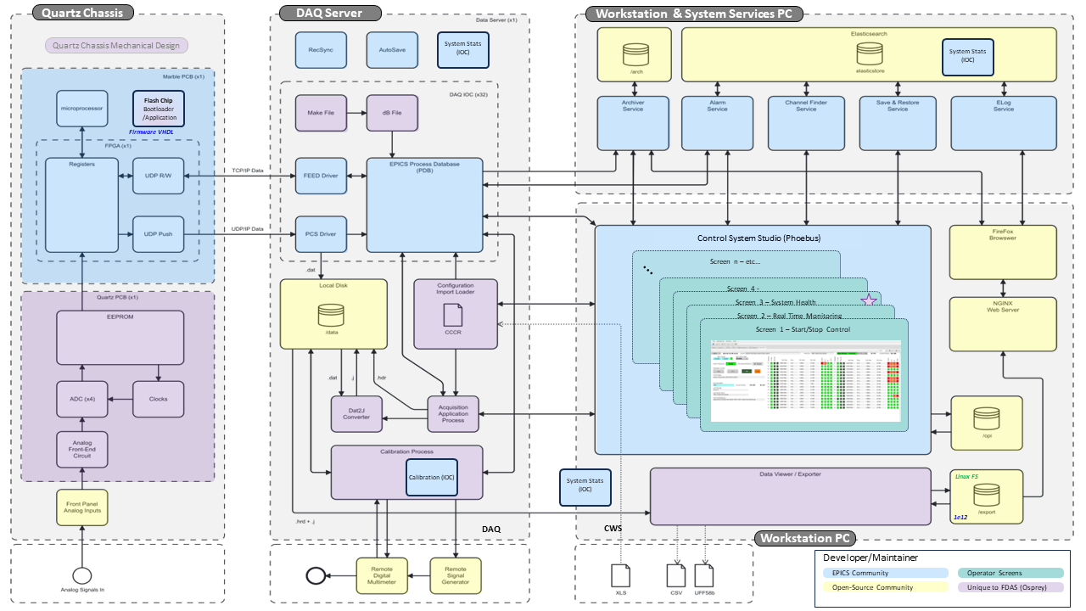
DAQ Software Architecture in Detail

